Slide 1
WiNDUP Critique
By Aditya Oka

Slide 2
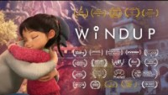

Slide 3
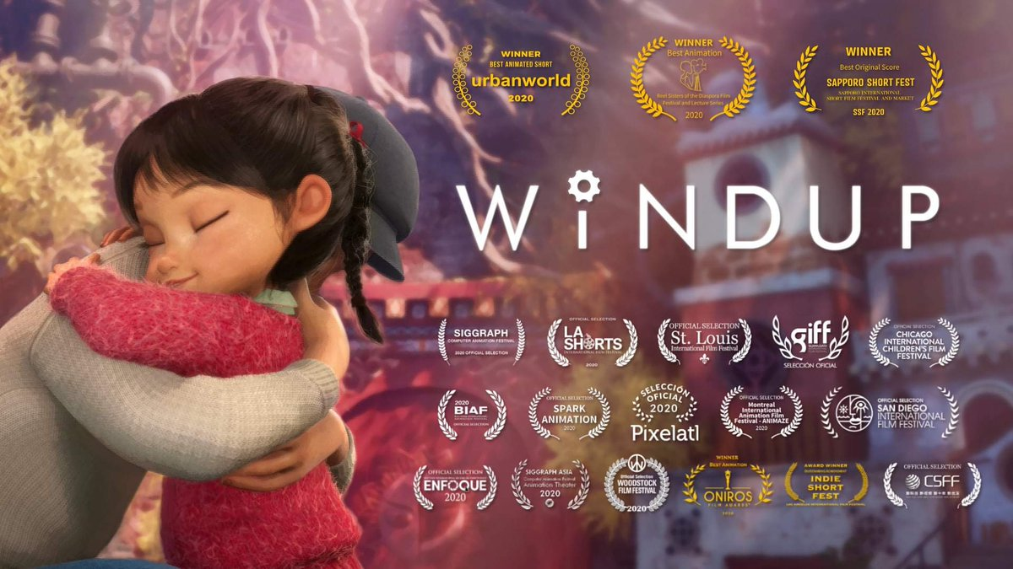

Details
Written and Directed by Yibing Jiang
Released on August 20, 2020
Team had members working from many different countries,
including United States, China, Sweden, and Denmark
Collaboration with Unity Technologies
Won awards in Urbanworld (Best Animated Short), USA Film Festival
(First Place Animation), Reel Sisters of the Diaspora Film Festival
(Best Animation), Sapporo Short Fest (Best Original Score), and
nominated in NAACP

Slide 4
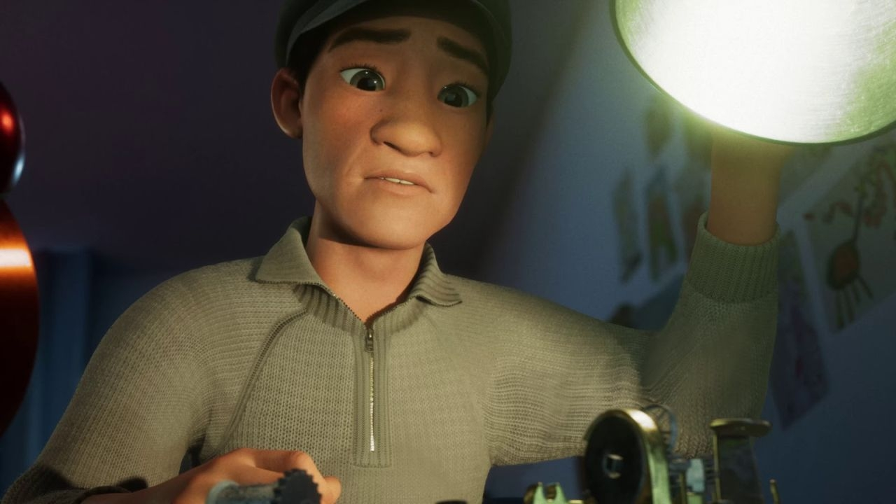
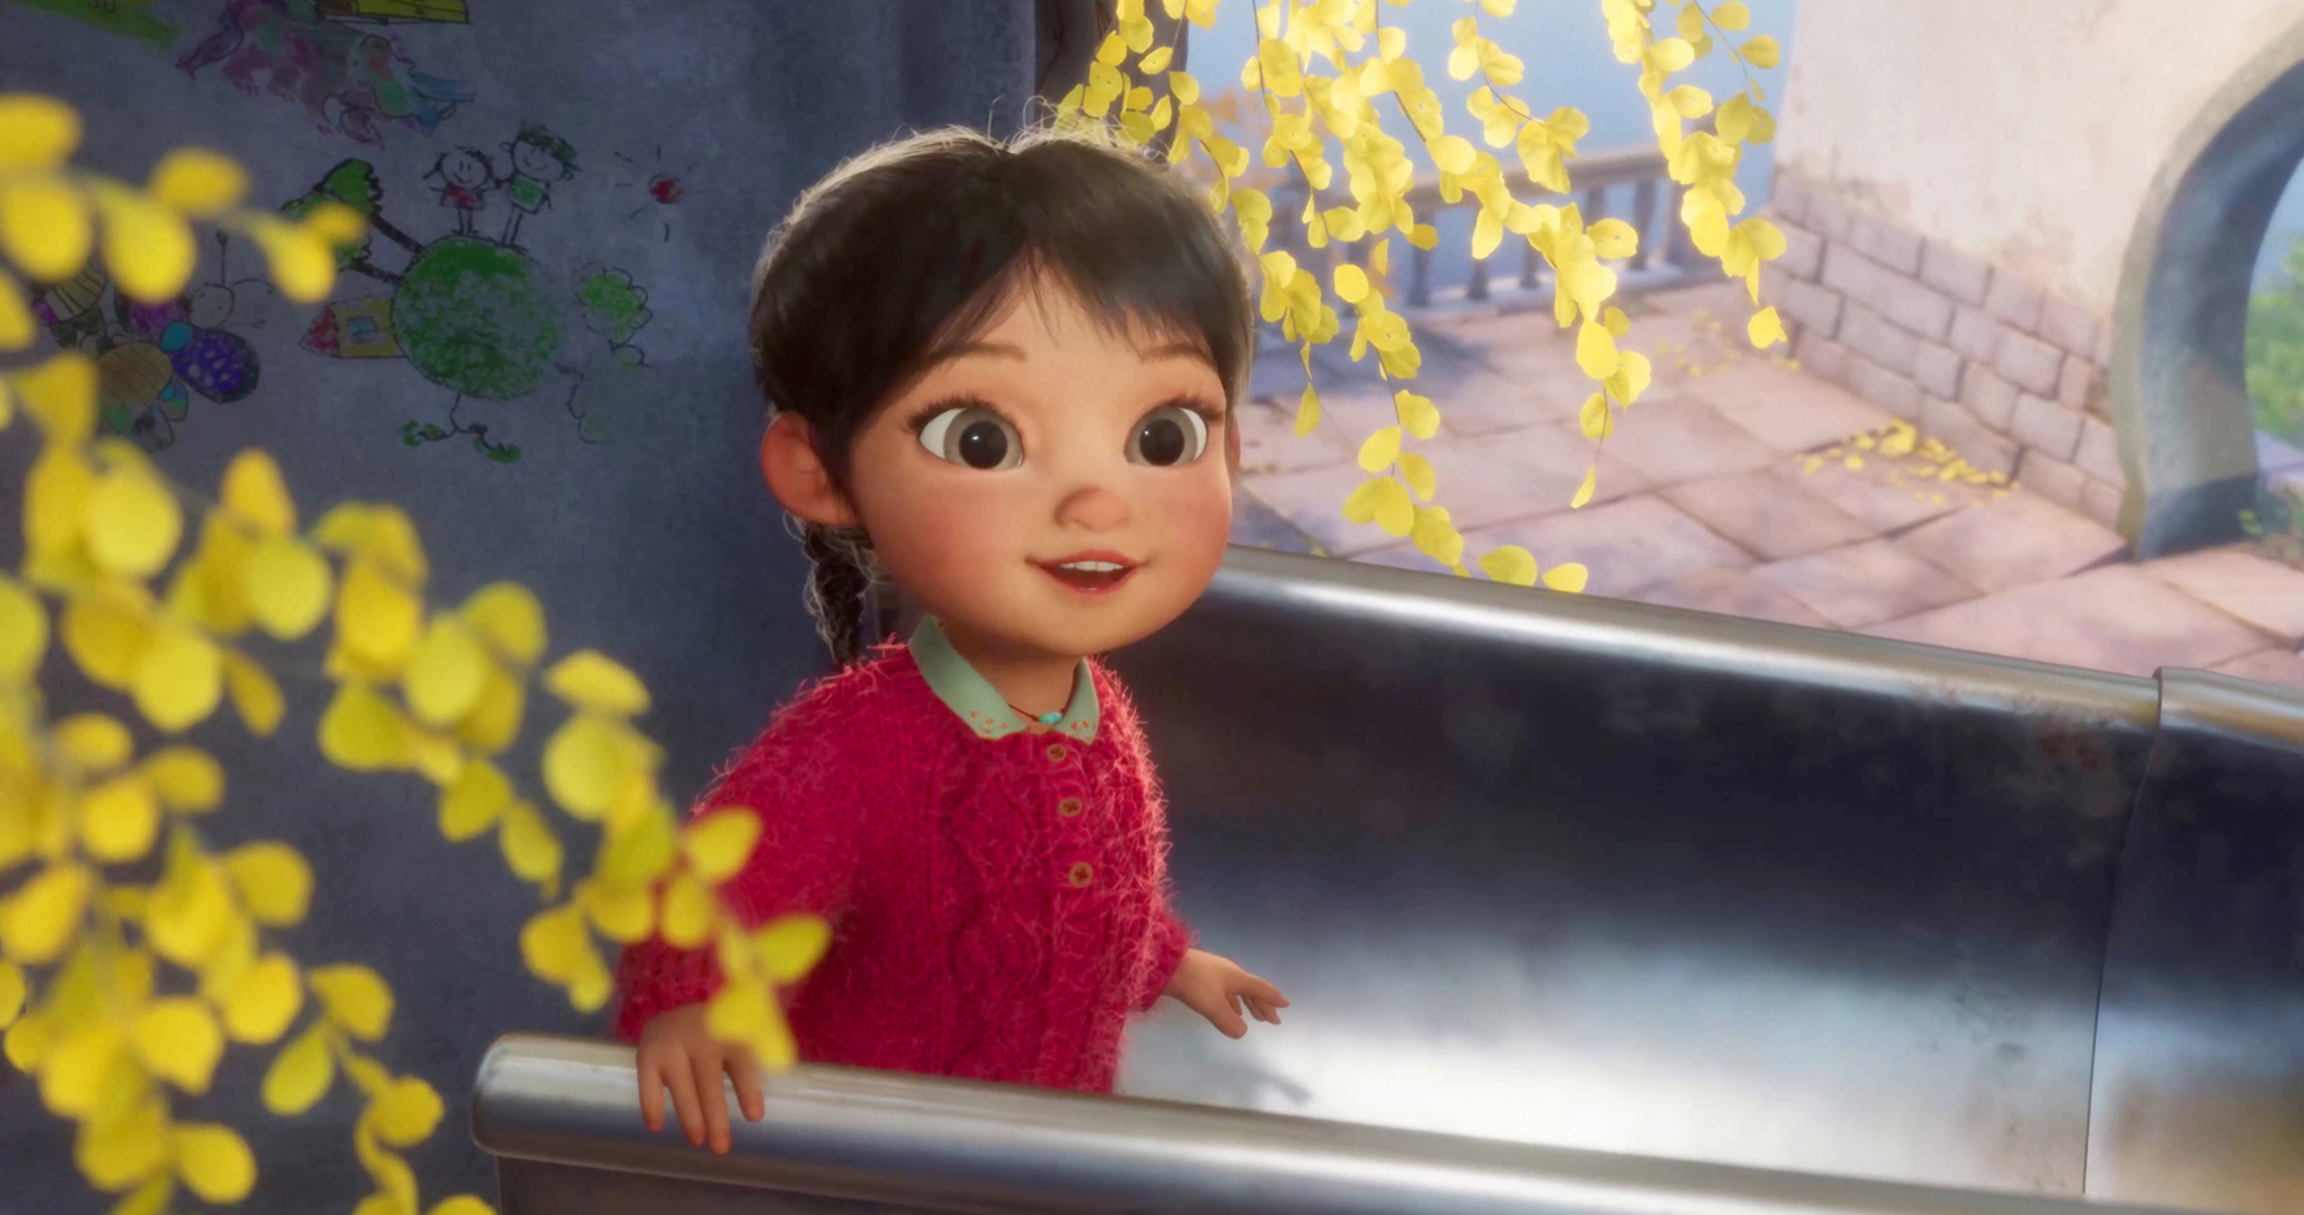
Summary
From the beginning, we see a father and daughter playing hide and seek together in a bedroom. Using the music box to create a melody that resonates with both the father and daughter, the daughter can find her dad in the closet. However, after that seemingly bright scenario, we are taken to the hospital room, where the father is looking over his daughter, who is bedridden from an unknown illness. As the father continues to watch over her and play the music box, the daughter tries to find her way back to the real world (back to her father) by following the music.
WiNDUP is a story of the love between a father and daughter persevering through trying times with the daughter making her way back to her father with the help of the melody from the music box.

Slide 5
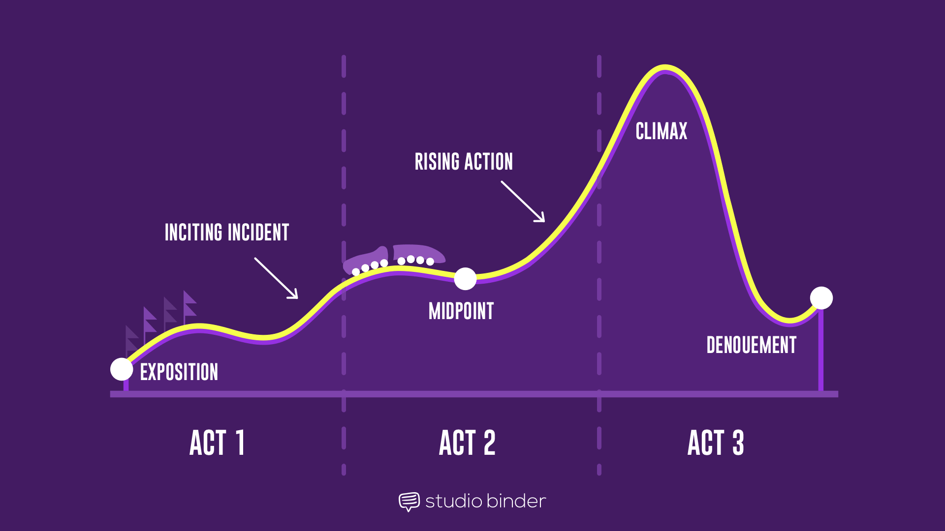
Act 1
Act 2
Act 3
3 Act Structure
Exposition:
Hide and Seek/First Music Box Play
Inciting Incident:
Daughter bedridden/exploring dream world
Rising Action:
Music box is broken, dad tries to fix/ice creeps into dream world
Climax:
Dad hums the tune/Daughter finds the stuffed bunny and the exit
Midpoint:
Timelapse of dad watching daughter
Denouement:
Daughter wakes up to see father

Slide 6

Technological Innovations
In the production of this film, the team used the real-time rendering technology from the Unity Game Engine. With this technology, the animators were able to:
View the result of the animation, with lighting and effects already rendered into the scene
Simultaneously collabarate and adjust the scene while working remotely due to COVID-19
This technology can make animating big complex scenes a lot easier and faster for studios.

Slide 7
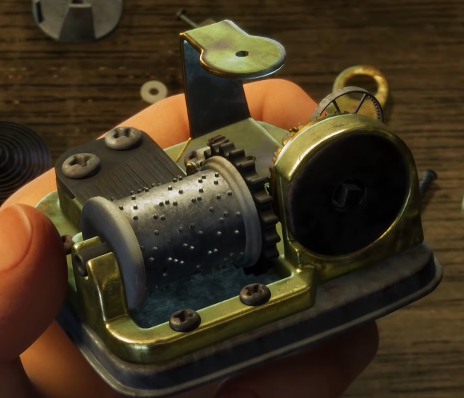
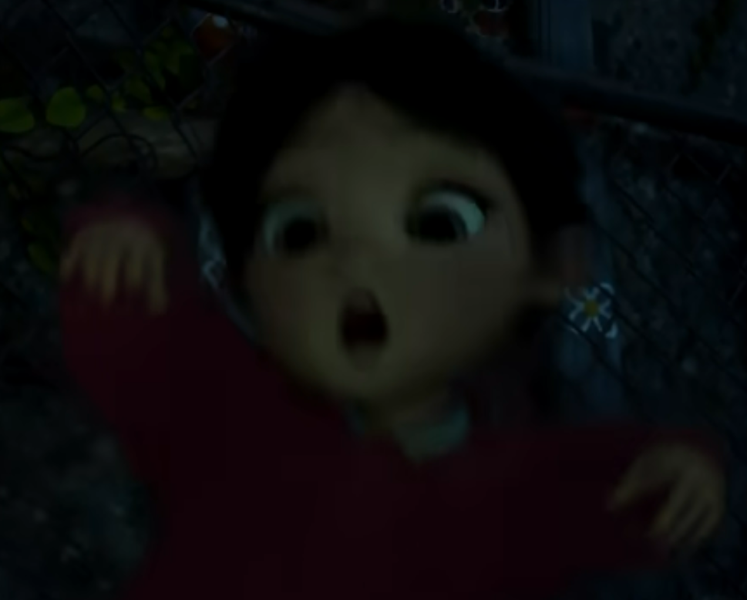
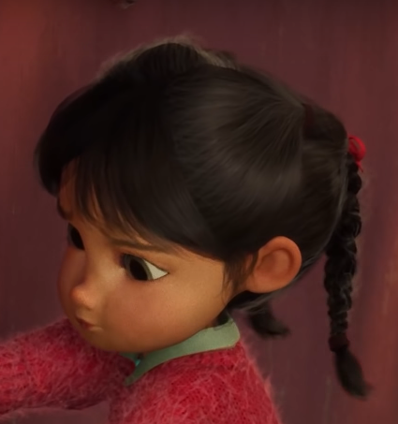
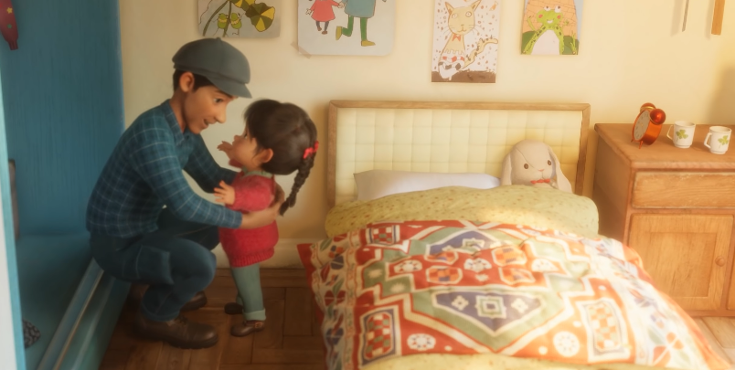
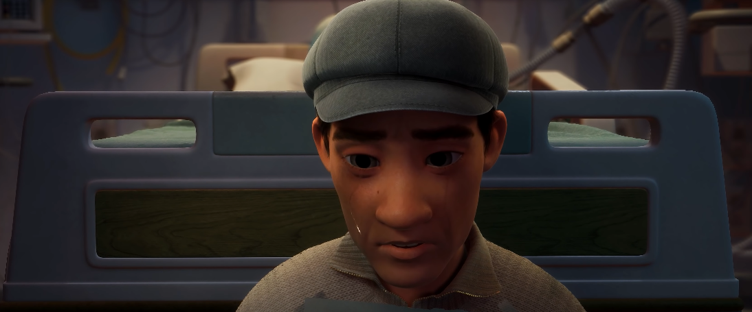
Animation Principles Part 1
Solid Drawing/Arc
The Music Box/Gears and trajectory of parts when it breaks
Secondary Action/
Overlapping Action/
Follow Through
Daughter’s pigtails flailing to her movement and her falling from the fence (fluid movement)
Staging
Dynamic Lighting and Focus matching tone of scenes

Slide 8
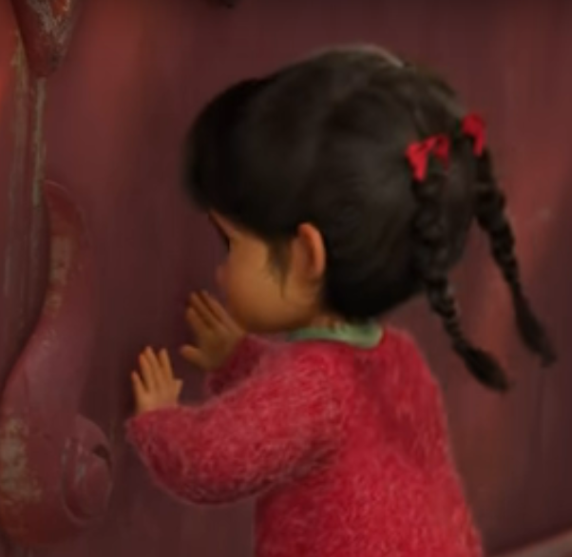
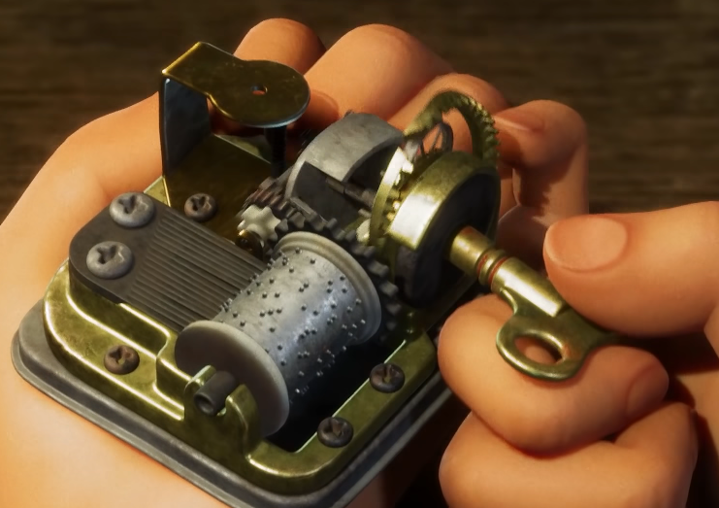
Animation Principles Part 2
Timing
Daughter trying to open doors
Anticipation
Dad trying to twist the knob of the broken Music Box

Slide 9
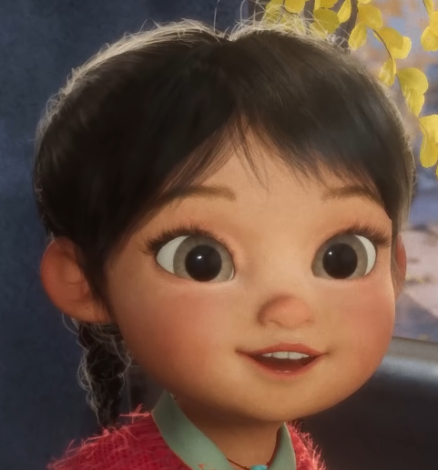
Personal Review?
Personally, I think this is a marvelous short film that is really relevant in the current state of the world. With COVID-19 still a big deal right now, worrying about family members, especially my relatives in India, has become normal in the past year. This film succeeds at really making you engaged emotionally with the struggles of the girl and the father here. Other than that, I felt that:
The pacing can be a little slow a times
The lighting was superb all the way through
Animation was really good, but can be stiff at times
Overall, I give this film a 4/5.

Slide 10
References
Jiang, Y. (2021, January 19). Windup: Award-winning animated short film | unity. YouTube. Retrieved October 30, 2021, from https://www.youtube.com/watch?v=efGqe1j3RNk.
Jiang, Y. (n.d.). Yibing's idea. Yibing's Idea. Retrieved October 30, 2021, from https://yibingjiang.com/.
Technologies, U. (n.d.). Windup. Unity. Retrieved October 30, 2021, from https://unity.com/demos/windup.
"Windup," Trailer for award-winning animated 9 minute short created with unity. CGSociety. (n.d.). Retrieved October 30, 2021, from https://cgsociety.org/news/article/5030/windup-trailer-for-award-winning-animated-9-minute-short-created-with-unity.

