Slide 1
VR LOCOMOTION
Aditya Oka

Slide 2
Immersion in VR Applications
Nowadays, virtual reality is widely available to consumers everywhere, along with widespread application support
While virtual reality presents infinite virtual environments to explore, movement is limited due to physical limitations
Without spending additional cash on equipment to make up for this, developers create locomotion methods to circumvent this limitation at the expense of immersion
Today, I will compare the 2 most used locomotion methods today and present 3 new locomotion methods that attempt to be practical and more immersive than the industry standards

Slide 3
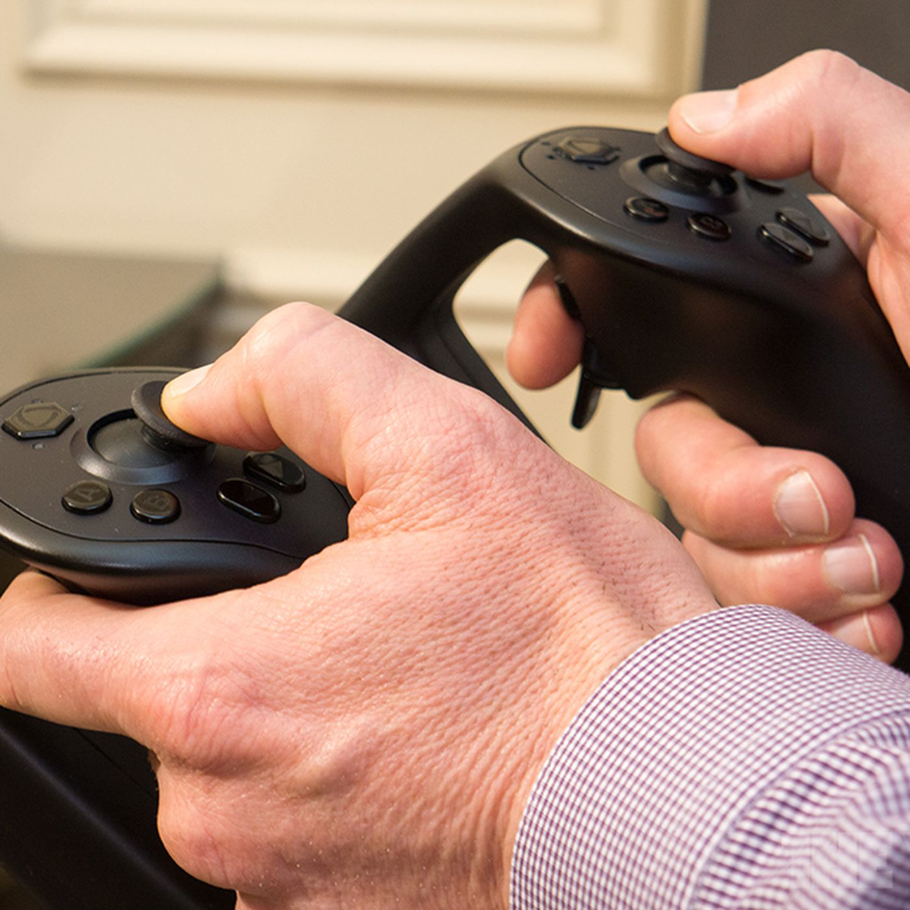
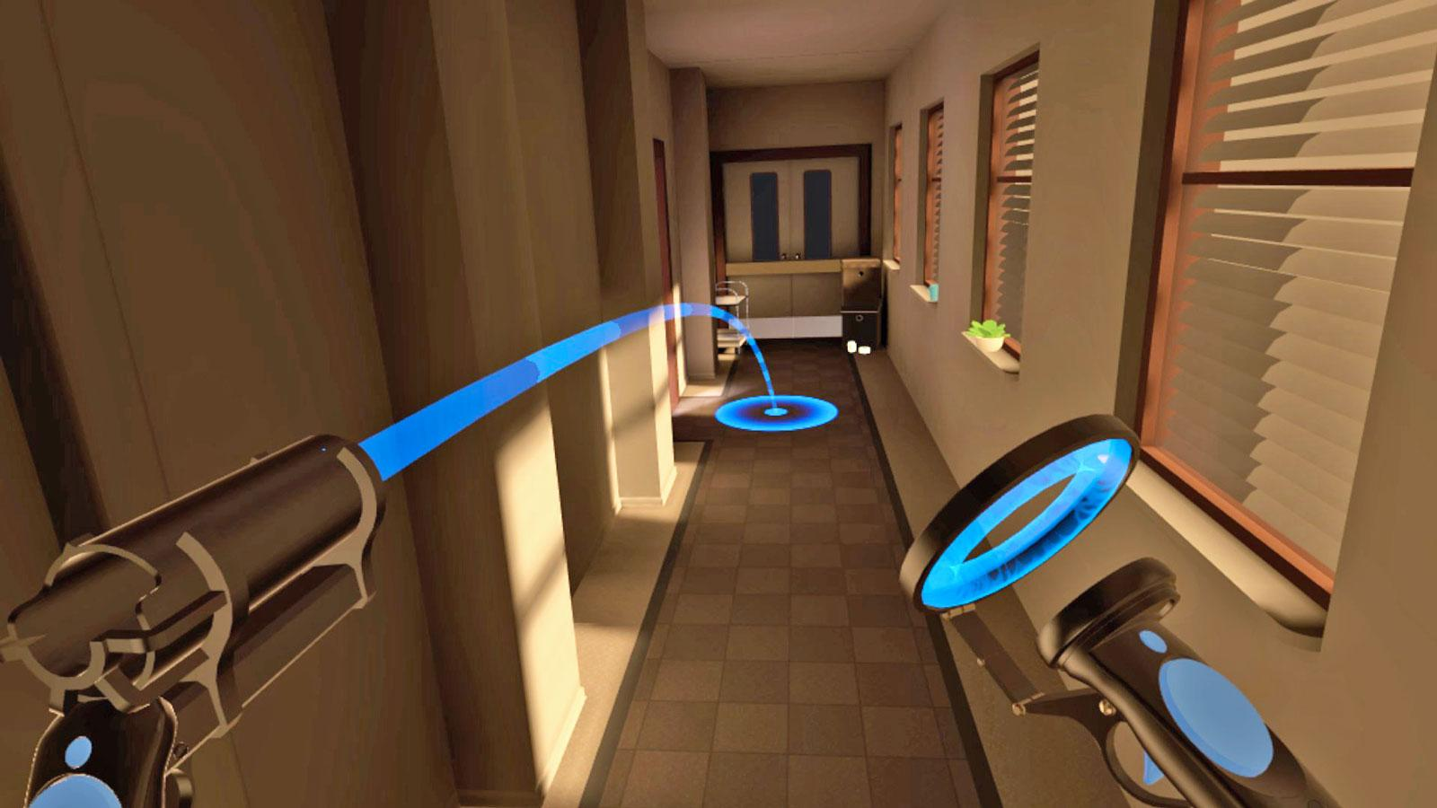
Most Used Locomotion Methods
Continuous Joystick Movement
Point-And-Teleport

Slide 4
Locomotion in Place in Virtual Reality: A Comparative Evaluation of Joystick, Teleport, and Leaning
Compares Joystick Movement, Teleportation, and Leaning Movement
75 Participants tested in terms of performance, sickness, immersion, and usability
Buttussi, F., & Chittaro, L. (2019). Locomotion in place in Virtual reality: A comparative evaluation of joystick, teleport, and leaning. IEEE Transactions on Visualization and Computer Graphics, 27(1), 125–136. https://doi.org/10.1109/tvcg.2019.2928304

Slide 5
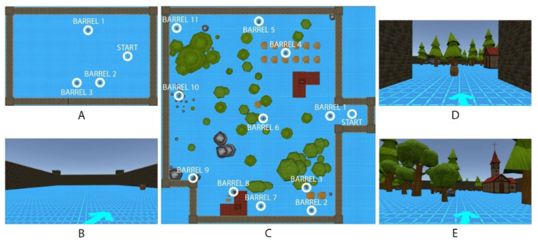
Test environment

Slide 6
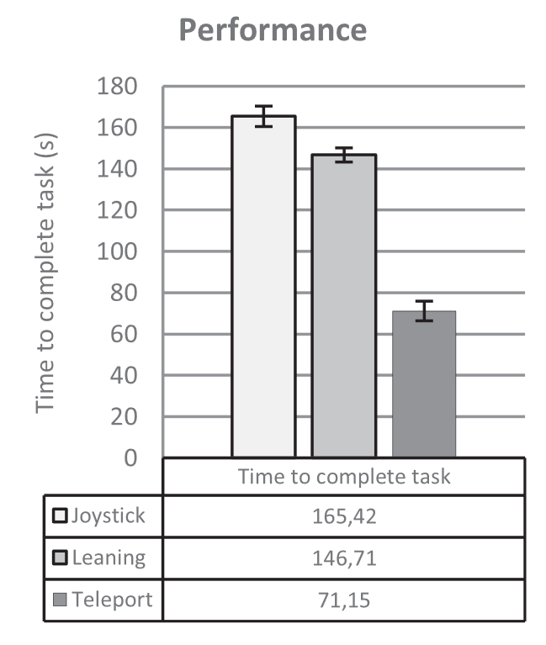
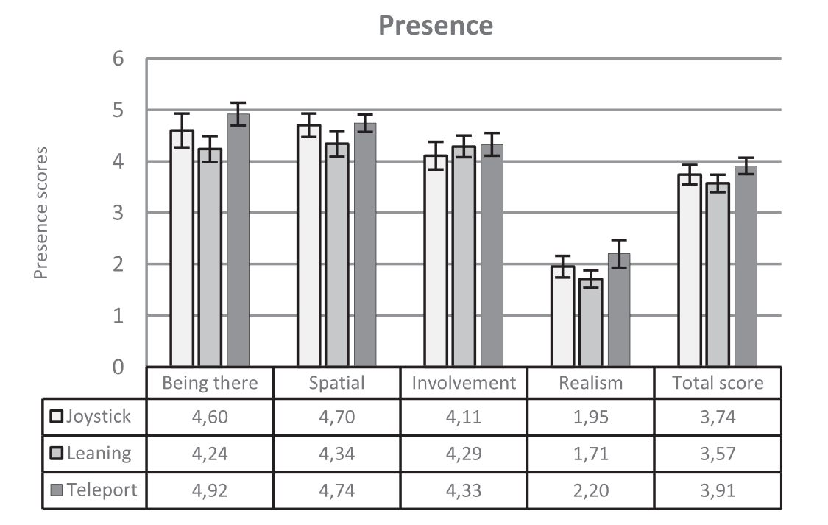
Performance and Presence results

Slide 7
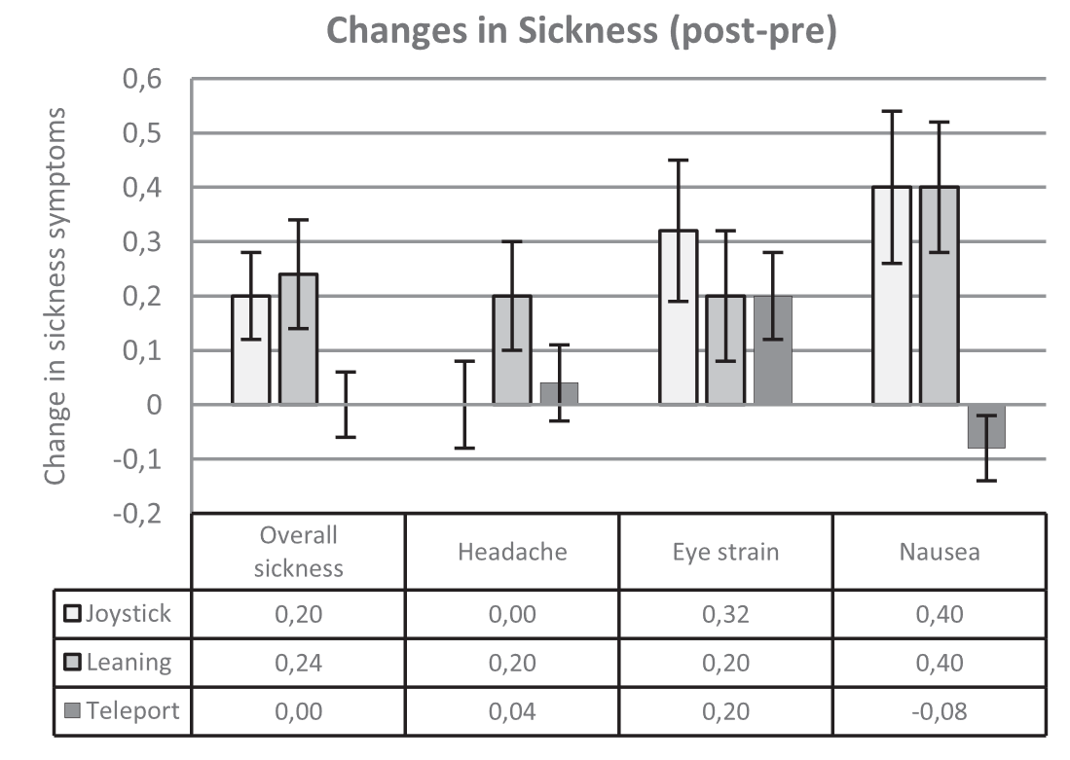
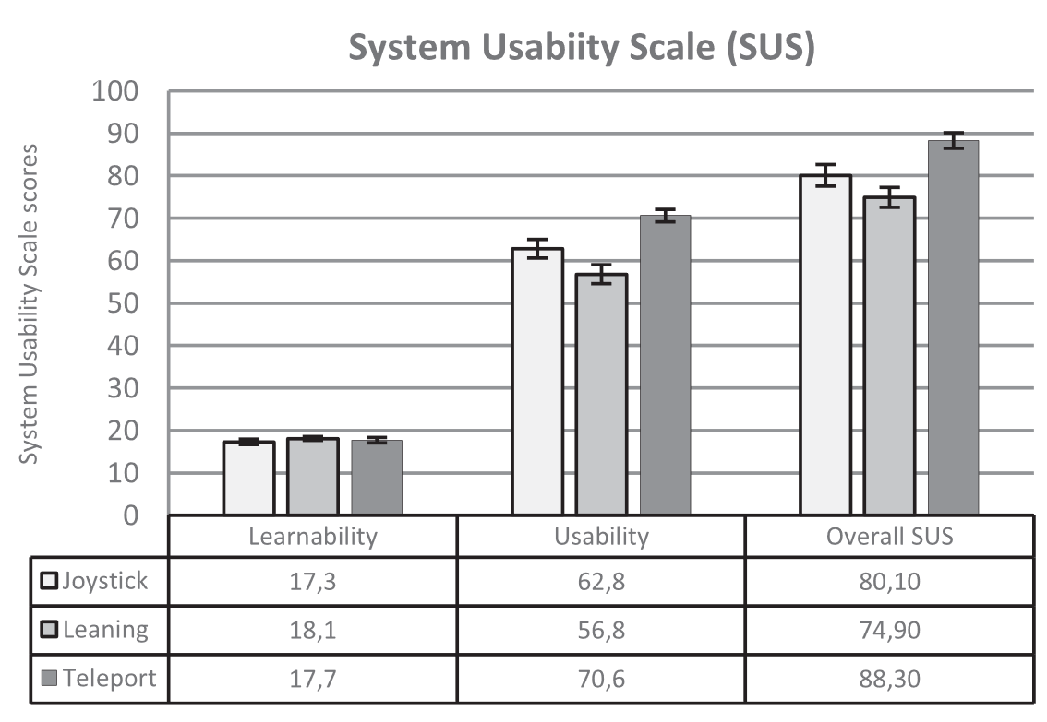
Sickness and Usability results

Slide 8
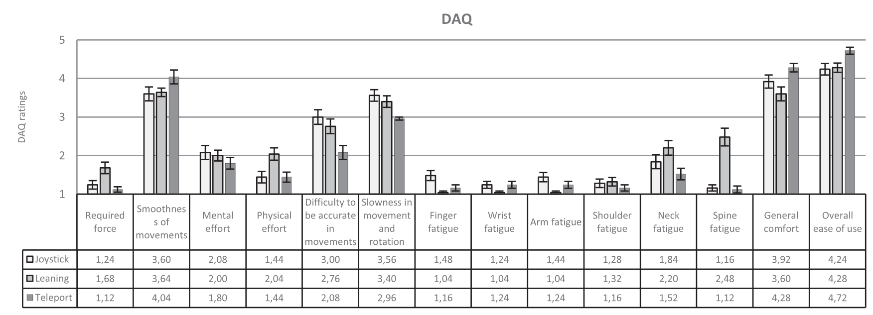
Fatigue (Device assessment questionnaire) results

Slide 9
Locomotion in Place in Virtual Reality: A Comparative Evaluation of Joystick, Teleport, and Leaning Results
From most of these tests, teleportation received the most positive ratings in every metric, while leaning and joystick movement were behind
leaning better in performance and arm fatigue
joystick better in required force, spine fatigue, and physical exertion
Teleportation leaves the “continuous” movement to the physical body, possibly leading to better presence and comfort ratings

Slide 10
Locomotion in Place in Virtual Reality: A Comparative Evaluation of Joystick, Teleport, and Leaning Flaws
Sample size is limited
All participants are computer science students within 20-26 years old
Only 7 participants

Slide 11
Evaluation of Immersive Virtual Reality Locomotion Mechanisms
Similar to previous paper, compares joystick movement and teleportation (along with some variations)
7 participants tested in immersion, comfort, performance, usability
Tanaka, E., Paula, T., Silva, A., Antunes, V., Domingues, L., de Almeida, L., Alves, A., & Oliveira, R. (2020). Evaluation of Immersive Virtual Reality Locomotion Mechanisms. Proceedings of the 19th Brazilian Symposium on Human Factors in Computing Systems. https://doi.org/10.1145/3424953.3426550

Slide 12
Evaluation of Immersive Virtual Reality Locomotion Mechanisms Results
Unfortunately, the paper’s tables are blurry and hard to read.
Sections:
                I quickly learned to move around the scene.
It is possible to move through the scene without the help of developers
It's quick to move where I want
I didn't feel sick or dizzy wearing the VR glasses as I moved around the scene.

Slide 13
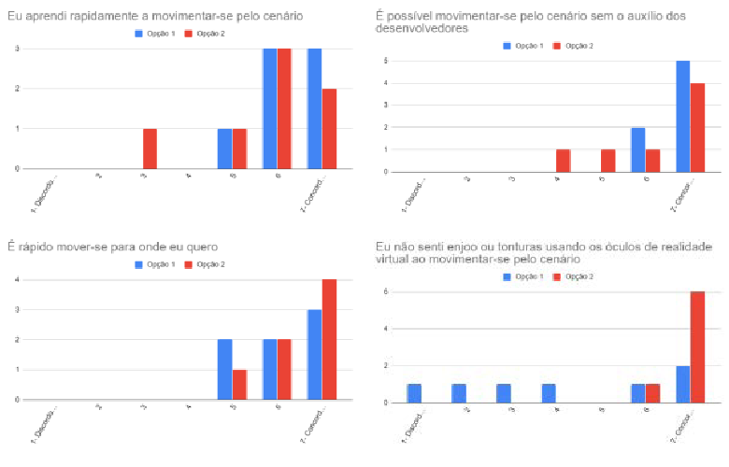
Comparison results (Blue – joystick, Red – teleportation)

Slide 14
Evaluation of Immersive Virtual Reality Locomotion Mechanisms Results
Here the participants felt the teleportation method was less natural and harder to pick up, but it still induced less sickness
Joystick movement performed better here
From both studies, ease of use seems to be interchangeable

Slide 15
Evaluation of Immersive Virtual Reality Locomotion Mechanisms Flaws
Sample size is still limited
Only 7 participants, so limited data

Slide 16
A Distributed Virtual Reality Study Under COVID-19 Conditions – Comparing Continuous and Non-Continuous Locomotion Techniques in Mobile VR
Comparison Study of Continuous and teleportation movement ran during pandemic using phones as screens in VR HMDs
Similar parameters tested: immersion, usability, and comfort
Dresel, M., & Jochems, N. (2021). A distributed virtual reality study under COVID-19 conditions – comparing continuous and non-continuous locomotion techniques in Mobile VR. Mensch Und Computer 2021, 406–411. https://doi.org/10.1145/3473856.3473996

Slide 17
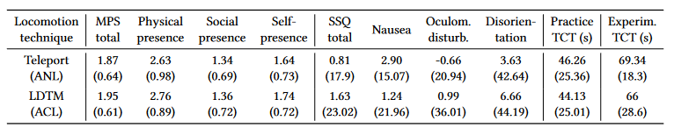
Test results

Slide 18
A Distributed Virtual Reality Study Under COVID-19 Conditions – Comparing Continuous and Non-Continuous Locomotion Techniques in Mobile VR Results
Both continuous and teleportation methods do not have significant differences between each other
From all three papers, it seems both of these methods are interchangeable, completely subjective based on the user’s experience
One consistent aspect: joystick movement makes people more sick

Slide 19
A Distributed Virtual Reality Study Under COVID-19 Conditions – Comparing Continuous and Non-Continuous Locomotion Techniques in Mobile VR Flaws
Sample size is adequate this time
All participants were using different smartphones, leading to higher margin of error
Due to pandemic, tests were ran in subject’s homes (uncontrolled environments)

Slide 20
New Locomotion Methods!

Slide 21
Design of Finger Gestures for Locomotion in Virtual Reality
Study on newly developed finger gesture movement
Using a depth camera and a mapping algorithm, 20 participants run the movement test measuring control, preference, fatigue, and sickness
Huang, R., Harris-Adamson, C., Odell, D., & Rempel, D. (2019). Design of finger gestures for locomotion in virtual reality. Virtual Reality & Intelligent Hardware, 1(1), 1–9. https://doi.org/10.3724/sp.j.2096-5796.2018.0007

Slide 22
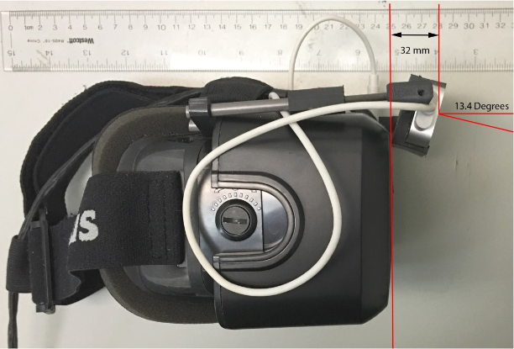
VR Hmd and Depth Camera

Slide 23
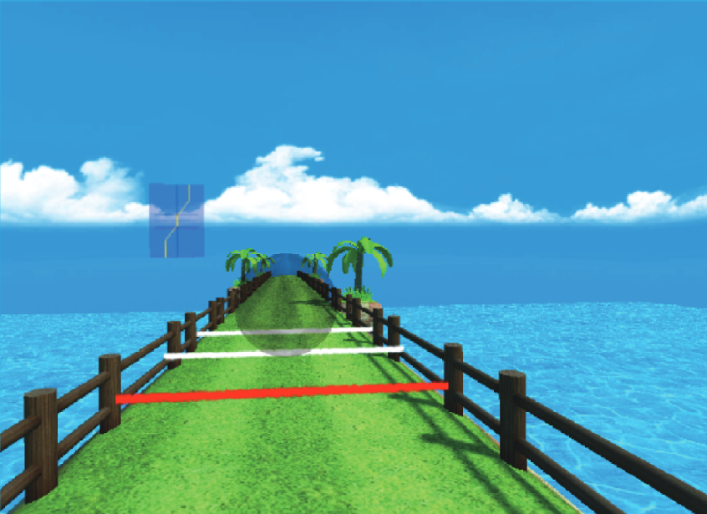
Test Environment

Slide 24
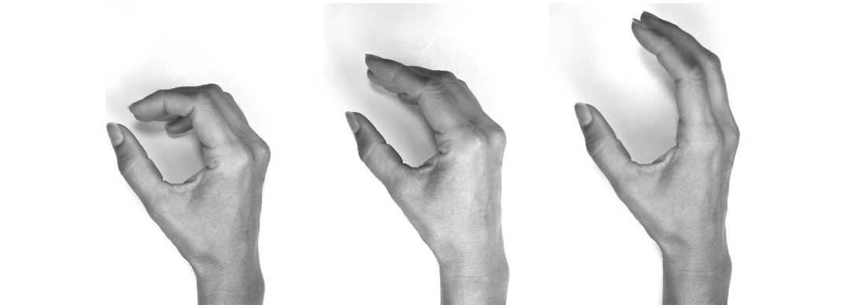
Gestures for movement

Slide 25
Design of Finger Gestures for Locomotion in Virtual Reality Results
5 subjects were unable to complete the test due to sickness
Unviable mode of locomotion currently
With additional tweaks with the dead zone and velocity slope, this can grow to be a viable method

Slide 26
Design of Finger Gestures for Locomotion in Virtual Reality Flaws
Only 18-year-olds tested in this paper
Algorithm only accommodates forward and backward movement

Slide 27
Podoportation: Foot-Based Locomotion in Virtual Reality
Research focused on new type of teleportation locomotion, podoportion (Teleportation controlled by feet)
Tested different directional and distance inputs to control teleportation on TCT and accuracy (20 participants)
von Willich, J., Schmitz, M., Müller, F., Schmitt, D., & Mühlhäuser, M. (2020). Podoportation: Foot-based locomotion in virtual reality. Proceedings of the 2020 CHI Conference on Human Factors in Computing Systems. https://doi.org/10.1145/3313831.3376626

Slide 28
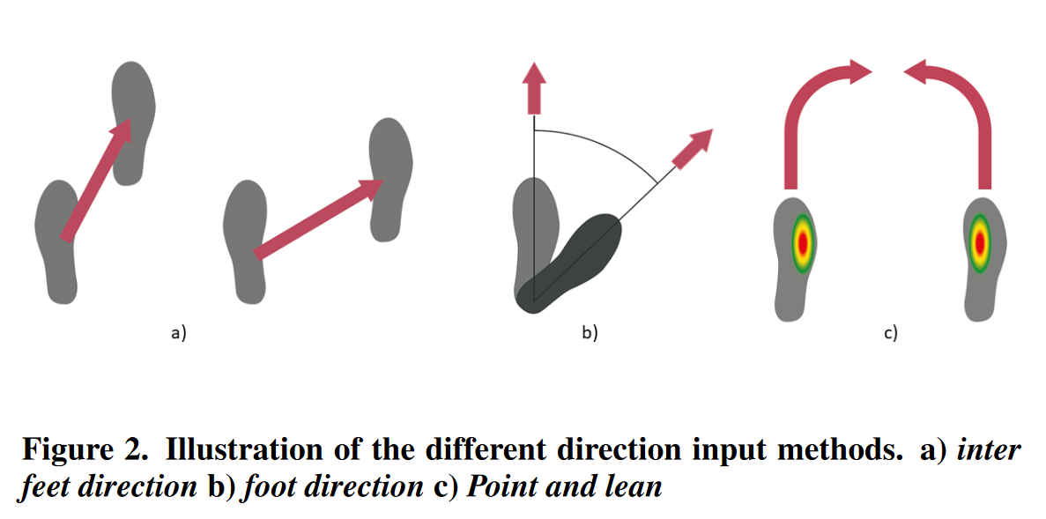
Direction Gestures for Teleportation

Slide 29
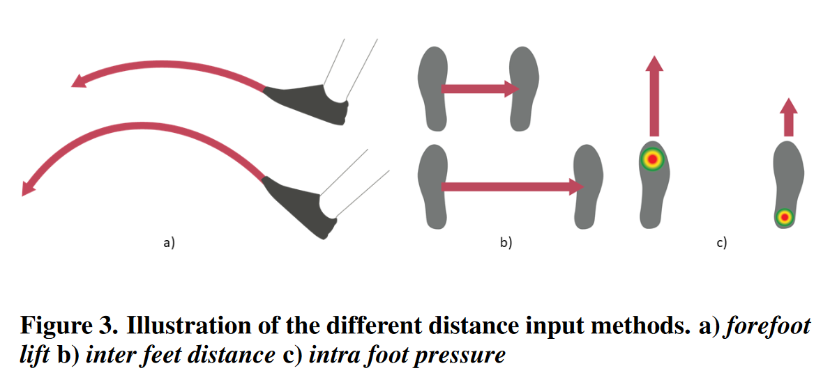
Distance Gestures for Teleportation

Slide 30
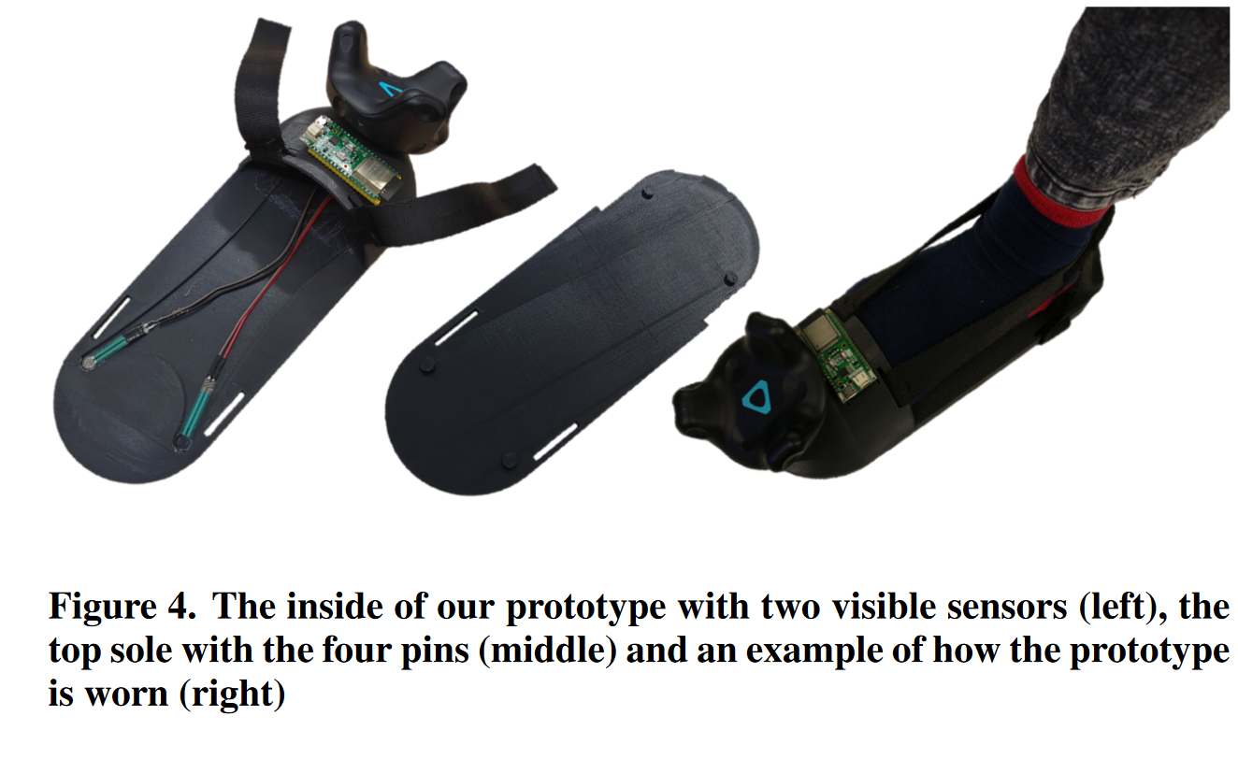
Foot Sensors for testing

Slide 31
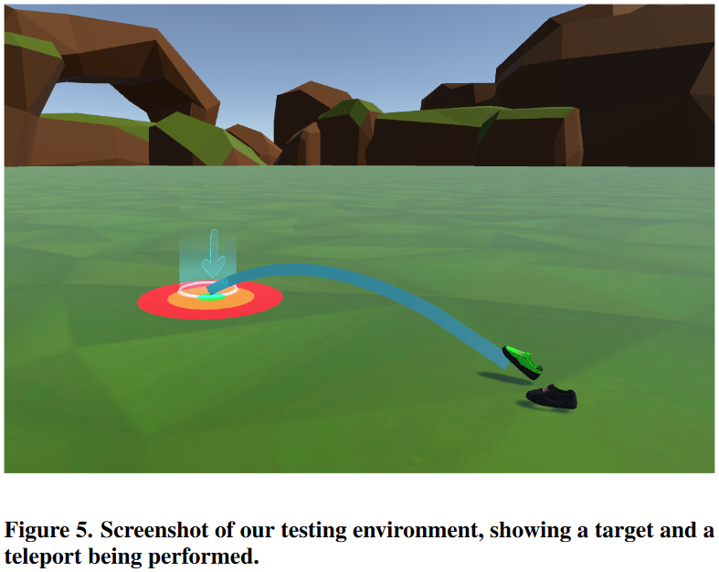
Test Environment

Slide 32
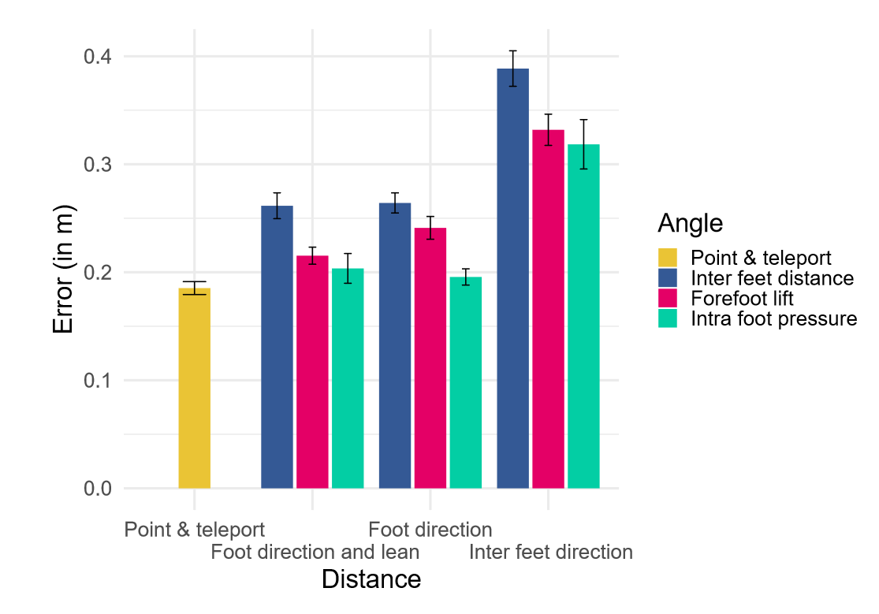
Test Results

Slide 33
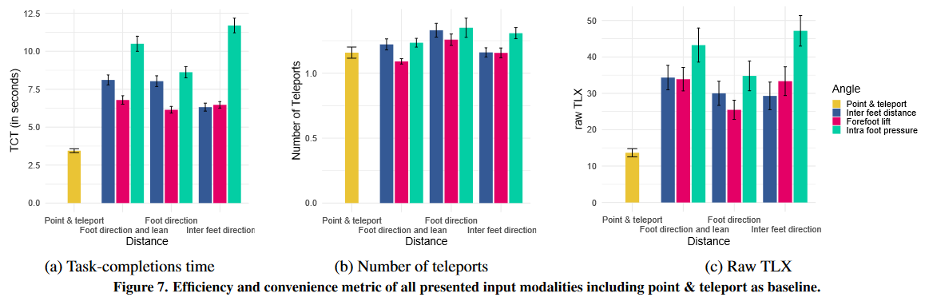
Test Results

Slide 34
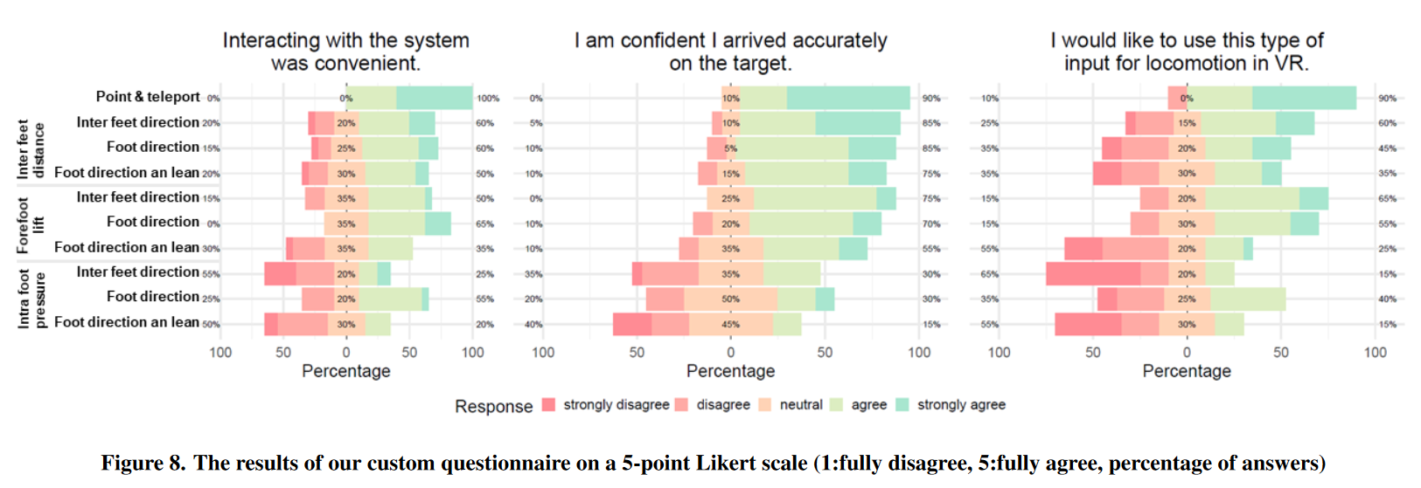
Questionnaire Results

Slide 35
Podoportation: Foot-Based Locomotion in Virtual Reality Results and Flaws
Point and teleport is shown to be more efficient and accurate to use
Can be a result of the subject’s prior experience, leading to a clear bias
Subject selection was diverse (6 female, 1 non-binary, ages 20-31)
Has potential to become a new standard as it frees up the arms for other tasks

Slide 36
Underwater Virtual Reality System for Neutral Buoyancy Training: Development and Evaluation
Studies emulation of zero-gravity virtual reality, including locomotion and the use of the Neutral Buoyancy test
Testing for mainly the presence factor, 9 subjects (3F, 6M) run the vR application submerged in water and sitting on a chair
Sinnott, C., Liu, J., Matera, C., Halow, S., Jones, A., Moroz, M., Mulligan, J., Crognale, M., Folmer, E., & MacNeilage, P. (2019). Underwater virtual reality system for neutral buoyancy training: Development and evaluation. 25th ACM Symposium on Virtual Reality Software and Technology. https://doi.org/10.1145/3359996.3364272

Slide 37
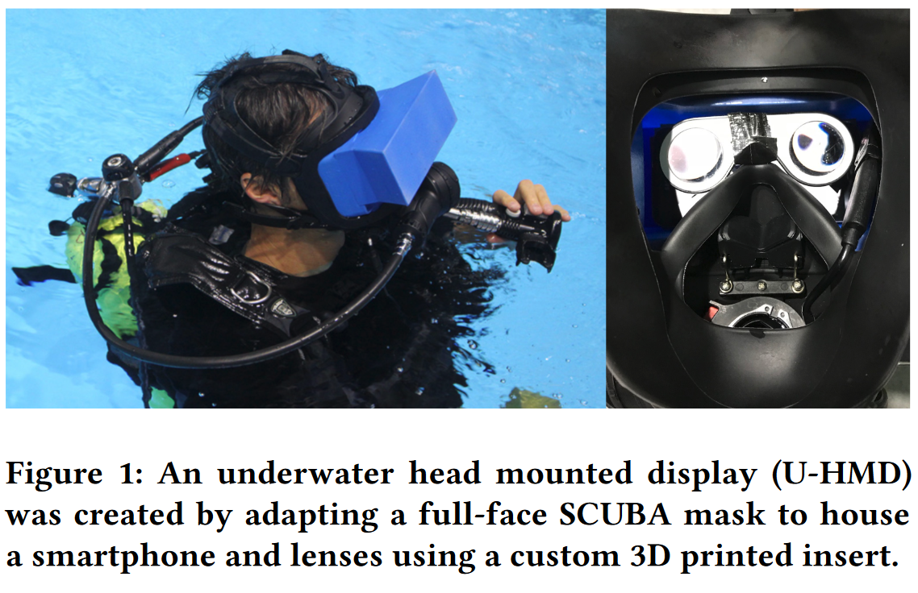
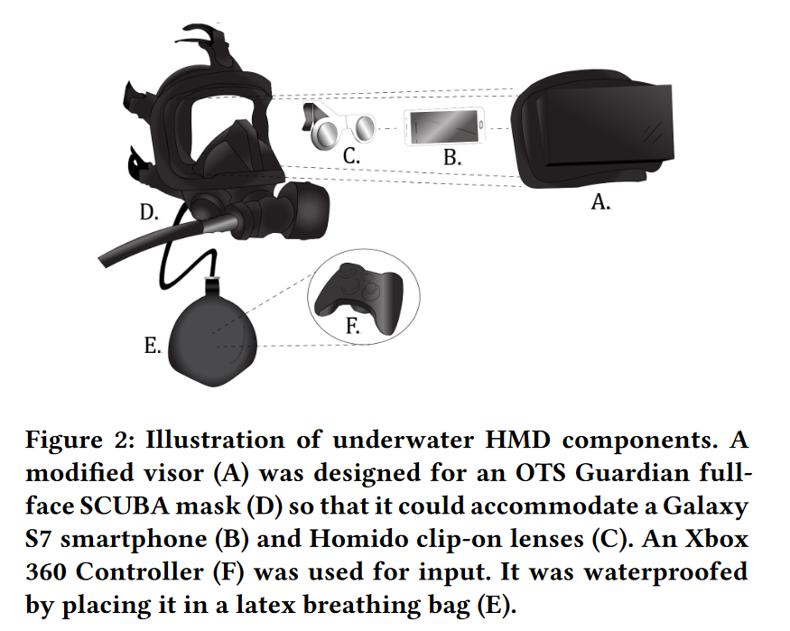
Underwater VR

Slide 38
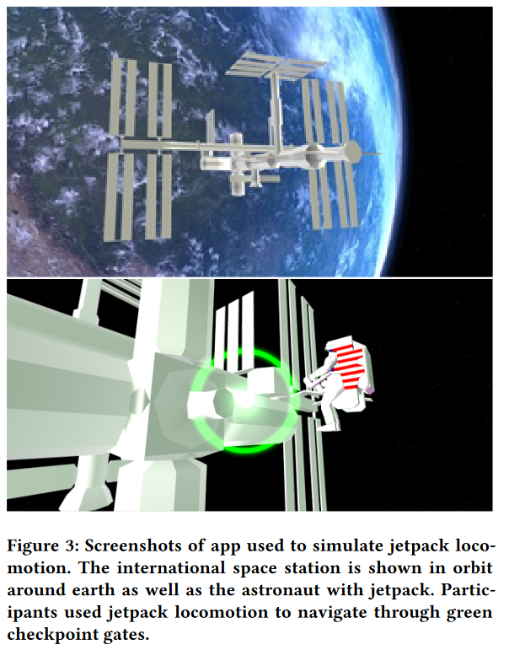
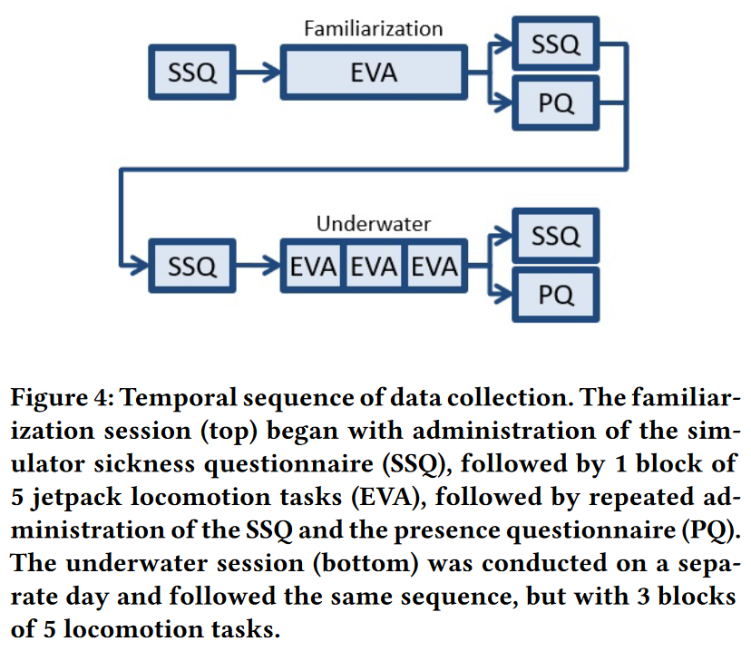
Test Environment and process

Slide 39
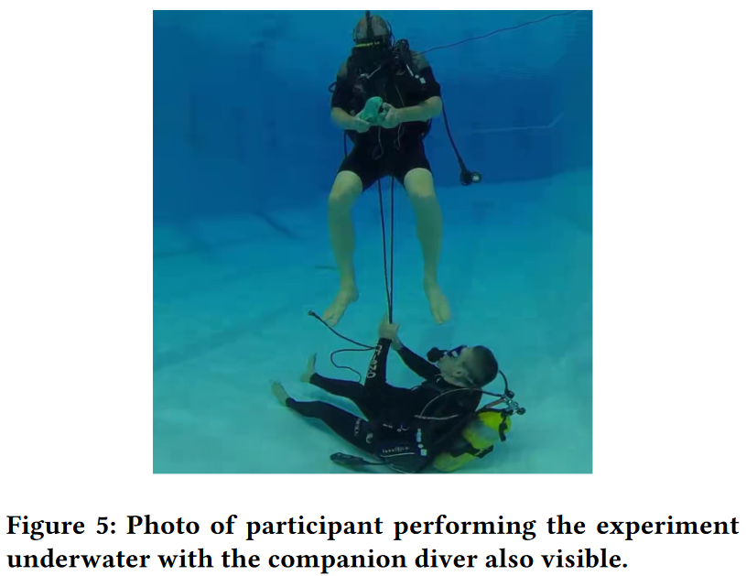
Picture of submerged test

Slide 40
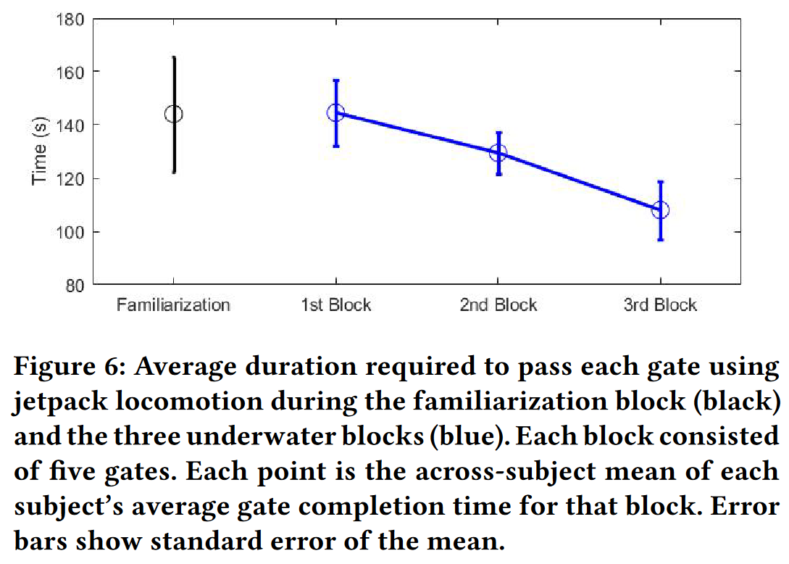
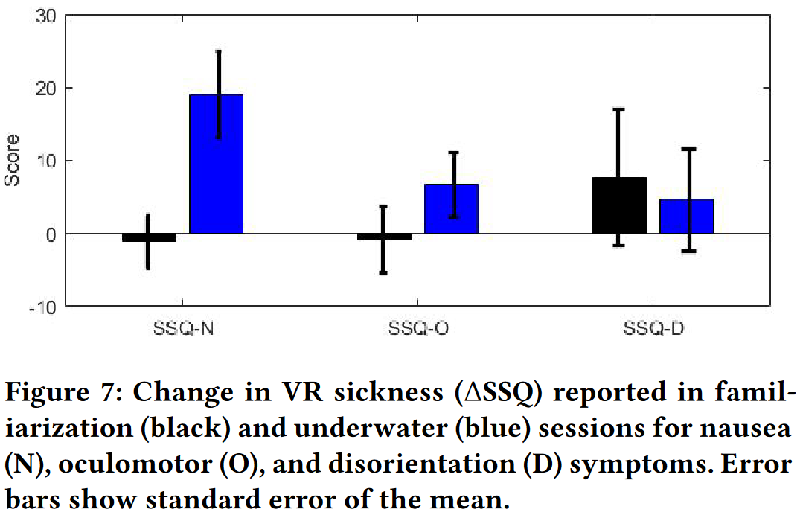
Test results

Slide 41
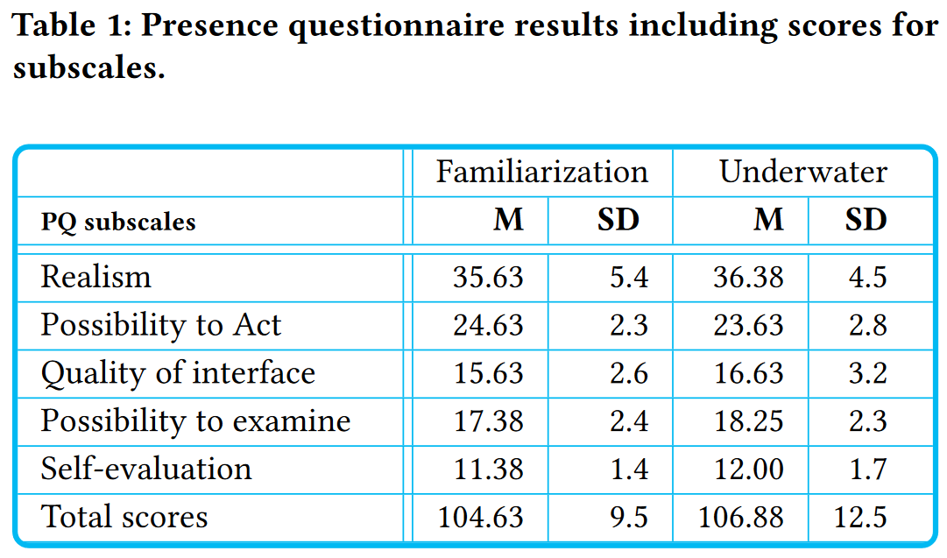
Questionnaire results

Slide 42
Underwater Virtual Reality System for Neutral Buoyancy Training: Development and Evaluation Results and Flaws
Submerged tests increase presence ratings a little, but causes noticeably more nausea
Jetpack locomotion system is unique and contributed to the high presence score
Has a lot of development potential
Can be used as an example for specialized vr locomotion systems
Only 9 participants, so data is limited

Slide 43
Conclusion
Neither Joystick nor teleportation movement are better than the other, completely based on user’s experience and preference
Teleportation induces less motion sickness than joystick movement
Finger gesture and Podoportion do not perform better than their established counterparts, but can be built upon in future research
Jetpack locomotion is a great basis for specialized immersive locomotion systems
Most papers presented had small sample sizes, leading flawed experiment results

Slide 44
Future Prospects
Full Dive VR and maybe more affordable gear to offer more immersive locomotion methods

Slide 45
Fin

