Slide 1
Final Animation Presentation
By Aditya Oka

Slide 2
Original Project Pitch
The story would show the tragedy behind the power of immortality, and the folly of a man who never asked for it.
Scene 0: A black, everchanging void shows until a bright light appears and slowly engulfs the screen, allowing for the sound of a newly born child to seep in.
Scene 1: Fading in, Ray, in first person and in the past, would look up at his “new” house and start walking to the front door, opening it to transition to the hallway scene
Scene 2: Ray, still in first person, goes through the hallway, glancing at each picture showing an important event of his past and remembering each memory through sound. The hallway scene would laid out with animated pictures along the walls to accomplish this.
Scene 3: After looking at all of the pictures and reaching the balcony, we are brought back to the present, where his house is surrounded by overbearing skyscrapers. An old yet young-looking Ray (can’t age), looks at one last picture of his wife and depressingly puts his head down before looking out at the continuously evolving world.

Slide 3
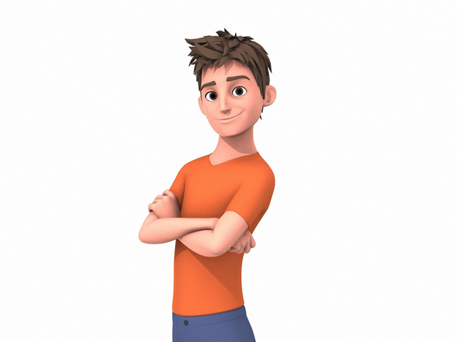
Characters
Ray:
The main character who was born in the late 1800’s and doesn’t age. After living, having his own family grow old without him, and even did some service in the military throughout the ages, he becomes old and withered mentally and emotionally by the end.

Slide 4
Storyboards
Website: https://adi-arts.com/

Slide 5
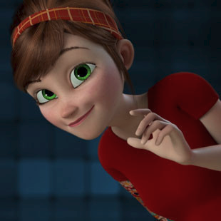
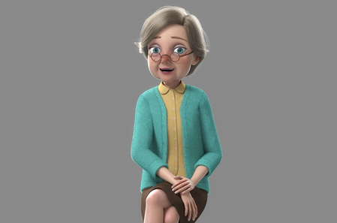
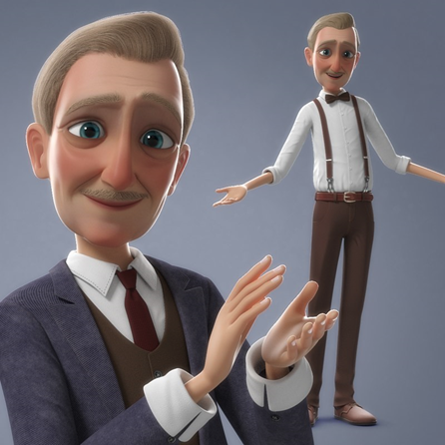
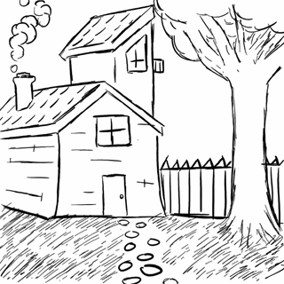
Changes
Originally, I intended to animated 4 characters, Ray as well as Jessy (the wife) the Mom, and the Dad, to create animated pictures.
Abandoned original first person idea, since it just didn’t look good.
Due to my complete lack of experience in Autodesk Maya, I decided to instead create a gallery of pictures as part of my hallway scene.
Again because of my lack of experience, I couldn’t feasibly model and texture my original house design, so I opted to find free house assets online (which proved to be very difficult for my specific parameters). Settled with a Wooden Shack and a Modern Brick House.

Slide 6
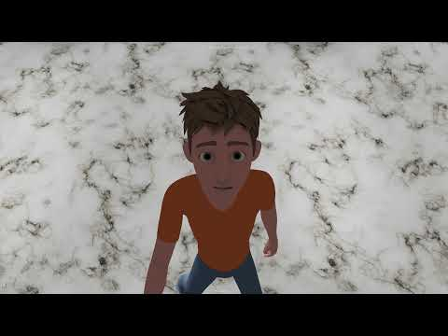
Final Composition (WIP)

Slide 7
Changes to do before submission
Smooth the mesh of Ray for Scene 1 (Wood Shack) and re-playblast
Add hand animations, a little more polish, and alter some of the camera positions in Scene 2 (Hallway)
Add in black and white picture version of Scene 2 into final composition
Add more skyscrapers and some cars strolling along to make Scene 3 (Brickhouse) a less empty and barren future city
Finally, add all of the sound effects for the final animation composition

Slide 8
End of Semester thoughts
Going into this course, I only had a very basic understanding of Animation principles and no experience using Autodesk Maya
While it was hard to get into the swing of things, I have learned a lot coming out of this course with all of the assignments and projects that I have done with the class
Thank you for a great learning experience and introducing me to 3D Animation!

