Slide 1

Applications of Game Engine Technology
By Aditya Oka

Slide 2
Game Engines
As video games start to become its own industry filled with developers, it became increasingly obvious that a software framework was needed to support the core functions of the game
  This is what a game engine is essentially: a framework consisting of supporting libraries and APIs to help create a base for the video game
While some companies develop and use inhouse game engines, like the Frostbite Engine, others such as Unity and Unreal Engine were made available to the public.
In the past two decades, these two game engines have grown to provide many tools catered towards game design but can also be used in other fields.
Today, I will present how game engine technology can be use in fields other than game design, particularly in animation, film, simulation, and education

Slide 3
Animation and Film

Slide 4
Fortnite: Supercharging CG Animation Pipelines with Game Engine Technology
Presentation of Unreal Engine’s capabilities in an animation production pipeline by Epic Games
Details the workflow using tools provided by Unreal Engine, including Sequencer and built-in animation tools
Pohl, B. J., Harris, A., Balog, M., Clausen, M., Moran, G., & Brucks, R. (2017). Fortnite. Proceedings of the ACM SIGGRAPH Digital Production Symposium. https://doi.org/10.1145/3105692.3114816

Slide 5
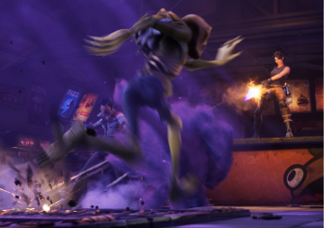
VFX real-time rendering in Unreal Engine
Real-time visual effects rendered while animating in Unreal Engine.

Slide 6
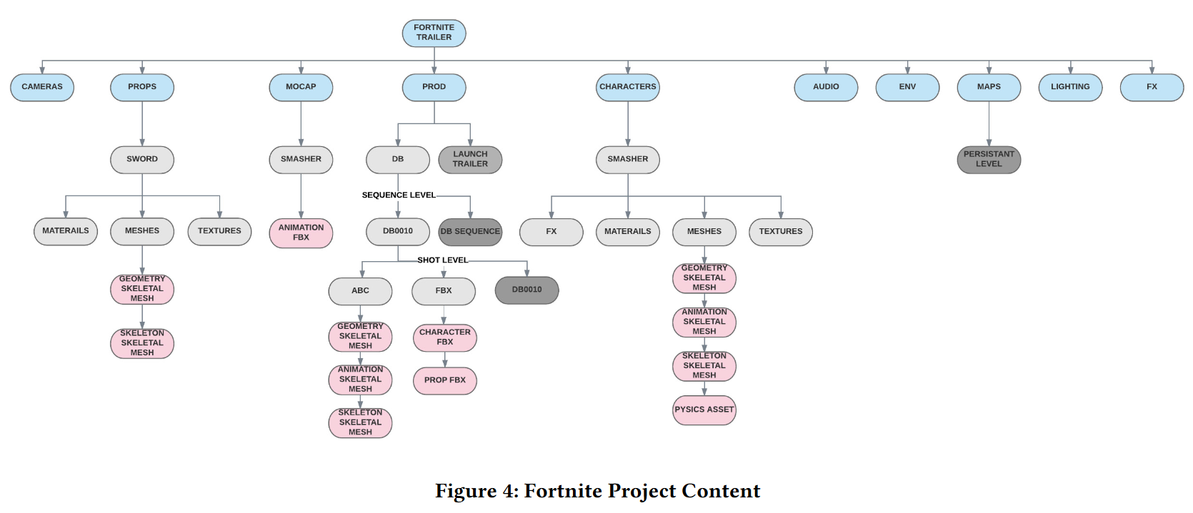
Project Content used for the Trailer
Files that were made as part of the animation workflow.

Slide 7
Fortnite: Supercharging CG Animation Pipelines with Game Engine Technology
Showcases the many tasks that can be done in Unreal Engine alone, streamlining the software requirements in production.
Preproduction with Sequencer, importing animations from Maya and enhancing them with Unreal’s Anim Dynamics (secondary animation)
Dynamic lighting, real-time rendering (keyword for a majority of the papers)
Production benefited from using the game engine timewise and efficiency-wise without too much drawback.

Slide 8
Fortnite: Supercharging CG Animation Pipelines with Game Engine Technology
No research or experiments comparing pipelines presented, only presentation (similar story for the next paper)
Hard to find papers on this specific topic

Slide 9
Application of Engine Technology and in 3D Animation Production
Looks into the potential benefits of game engine technology can have in animation, particularly regarding how it transforms the rendering phase of production
Describes how certain engine features, like shadows, HDR lighting, and custom halo effects, can be developed through DirectX and OpenGL
Tang, L. (2021). Application of engine technology and in 3D animation production. 2021 Third International Conference on Inventive Research in Computing Applications (ICIRCA). https://doi.org/10.1109/icirca51532.2021.9544664

Slide 10
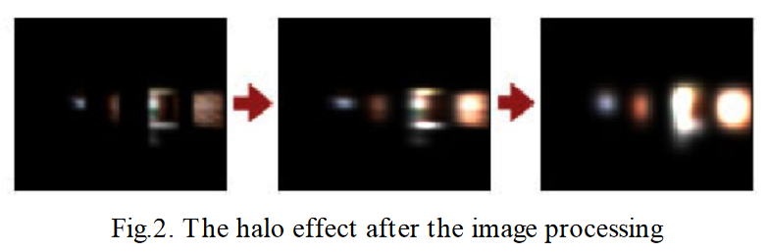
Halo Effect
Halo effect processing developed in the OpenGL game engine.

Slide 11
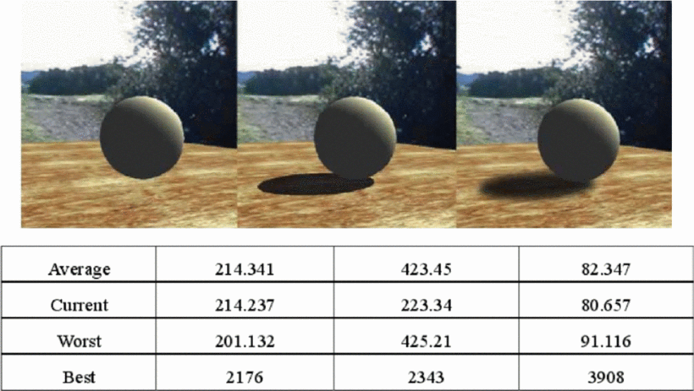
Shadow Effects
Shadow Effects based on modified algorithms developed in the OpenGL game engine.

Slide 12
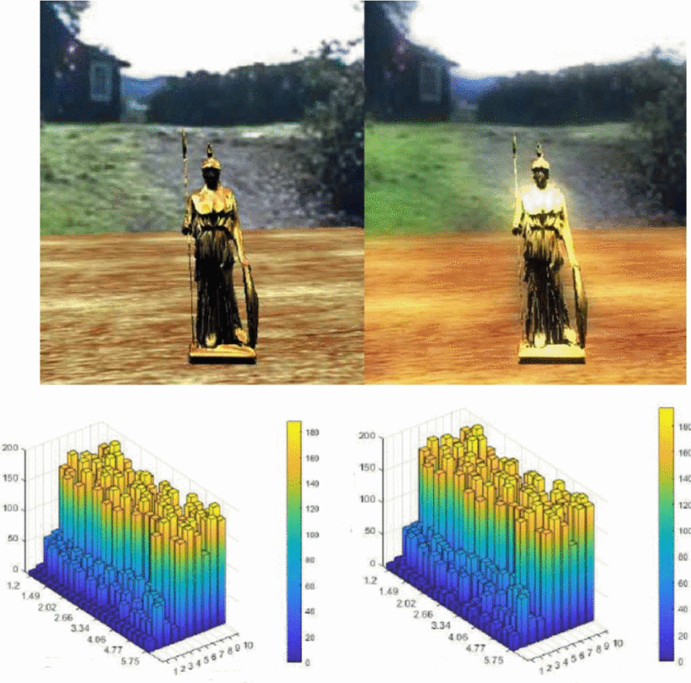
HDRI Effects
HDRI Effects developed in the OpenGL game engine.

Slide 13
Application of Engine Technology and in 3D Animation Production
Presents the core phases of animation and analyzes the workflows of each stage (pros and cons)
Creates another argument focusing more on how real-time rendering can make the production cycle drastically more flexible
Demonstrates how key components can be developed in a fledgling game engine out of OpenGL

Slide 14
Application of Engine Technology and in 3D Animation Production
Once again, no experiments were done to test if game engine technology supported production
Figures given only demonstrate the features developed in the OpenGL engine and isn’t compared to similar engines or traditional rendering

Slide 15
Interactive movie design based on the game engine technology
Investigates the film production pipeline and how game engine technology can positively influence the core phases
Includes more recent applications of game engines in popular shows/movies such as Ready Player One and The Mandalorian
Looks into the onset of interactive film, citing the episode “Bandersnatch” from Black Mirror
Fang, Z., Cai, L., Juan, G., & Wang, G. (2020). Interactive movie design based on the game engine technology. Proceedings of the 2020 4th International Conference on Electronic Information Technology and Computer Engineering. https://doi.org/10.1145/3443467.3443900

Slide 16
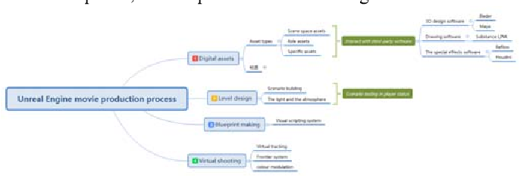
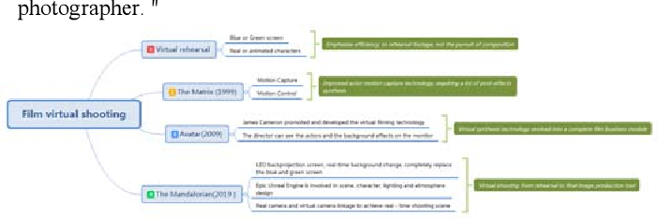
Production Workflow Diagrams
Visualization of the production workflows that were used during the popular films noted in the paper, such as The Mandalorian (Blurry)

Slide 17
Interactive movie design based on the game engine technology
Once again mentions how powerful real-time rendering can be in a major production, especially one with a majority of scene in CGI and filled with visual effects
Introduces virtual film shooting made possible through Unreal Engine with dynamic green screens, LED walls, and virtual sets/cameras, leading to increased control over a CG scene in a show like The Mandalorian
Interactive design over an episode, i.e. giving control to the audience to decide the future of the characters in the show. Multiple endings in one episode.

Slide 18
Interactive movie design based on the game engine technology
While it doesn’t offer much in terms of a research study, it provides a valuable insight into the production of major films of our generation
Delves really deep into Black Mirror’s interactive episode so much that it detracts from the main point introduced in this paper (takes up half of the whole paper)

Slide 19
Development of Character Design Frameworks using Game Engine: Unreal Engine
Focuses on the character design and animation tools provided by Unreal Engine, and how using the engine streamlined the pipeline in terms of software
Compares the two workflows (traditional vs Unreal) and examines the pros and cons of both
Nop, K., Manissaward, J., & Oattarapon, T. (2019). Development of character design frameworks using game engine: Unreal Engine. 2019 Joint International Conference on Digital Arts, Media and Technology with ECTI Northern Section Conference on Electrical, Electronics, Computer and Telecommunications Engineering (ECTI DAMT-NCON). https://doi.org/10.1109/ecti-ncon.2019.8692268

Slide 20
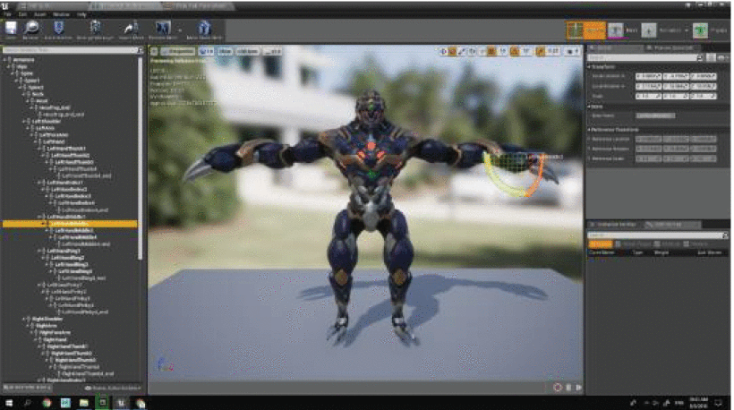
Unreal Engine Production
Screenshot of editing a character model that was imported directly from Autodesk Maya.

Slide 21
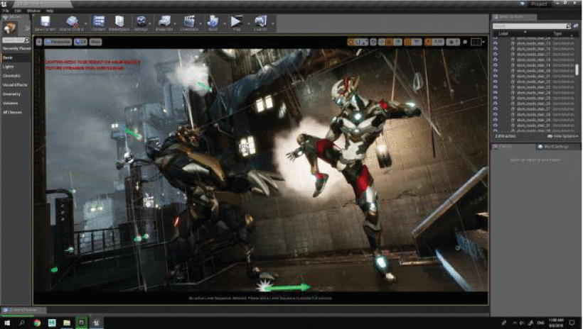
Unreal Engine Production
Screenshot of editing in Unreal Engine with a fully rendered scene complete with VFX.

Slide 22
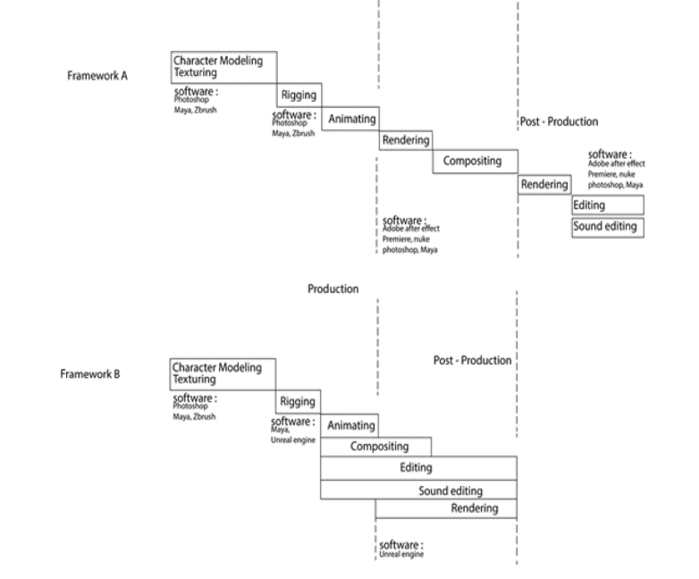
Production and Post Production Comparison
Framework A (Traditional) vs Framework B (Unreal Engine) in the production and post-production phases

Slide 23
Development of Character Design Frameworks using Game Engine: Unreal Engine
Unreal workflow was a lot more time efficient and flexible than the traditional workflow
With all the tools that Unreal provided, most of the post-production work could be done in the game engine itself (no need to use multiple different programs)
Provides a good argument to use alternative software to functionalities that can cross into different fields in Digital Media

Slide 24
Development of Character Design Frameworks using Game Engine: Unreal Engine
The paper doesn’t conduct any particular study, but tries to compare the two workflows based on the team’s experience

Slide 25
Simulation And Education

Slide 26
Development of Laparoscopic Cholecystectomy Simulator Based on Unity Game Engine
Looks into the development of a VR surgery simulator created in the Unity engine intended for educational purposes
Describes the key components that needed to be developed in-engine for the simulator to adequately provide near first-hand experience to the students.
Analyzes the benefits and detriments of using a game engine rather than using a proprietary system for the program
Zhang, J., Lyu, Y., Wang, Y., Nie, Y., Yang, X., Zhang, J., & Chang, J. (2018). Development of laparoscopic cholecystectomy simulator based on Unity Game Engine. Proceedings of the 15th ACM SIGGRAPH European Conference on Visual Media Production - CVMP '18. https://doi.org/10.1145/3278471.3278474

Slide 27
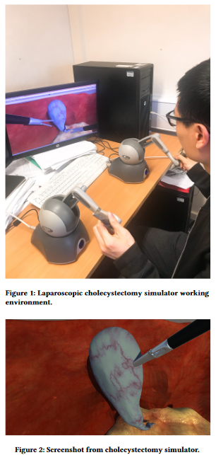
The Simulator in action
Picture of a participant using the simulator and an in-game screenshot of the surgery.

Slide 28
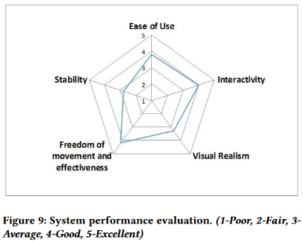
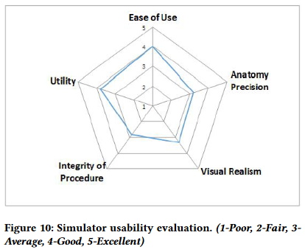
Evaluation and Feedback of the Simulator
The data showing what participants thought of the simulator.

Slide 29
Development of Laparoscopic Cholecystectomy Simulator Based on Unity Game Engine
Described the surgery process and the phases that would need to be translated into the simulator
Simulation components, how the were implemented (Volumetric Soft Body Simulation for the organs, Haptic Feedback)
Examined how using a game engine for development influenced the final program
  More time-efficient, better user-experience, and potential for group scenarios
  Limited physics tools due to being tailored for game development and not as precise animation/tracking

Slide 30
Development of Laparoscopic Cholecystectomy Simulator Based on Unity Game Engine
Only 15 participants for the initial tests, limited sample size (mentioned that evaluation strategy will be reworked)
While stability is somewhat lacking from the figures, every other metric is at least average. No comparison to a proprietary equivalent!

Slide 31
Using Game Technology to Automatize Neuropsychological Tests and Research in Active Aging
Develops a computerized version of the 15 Objects Test (15-OT) using the Unity game engine
Compares with the paper version in term of data collection, mean scores, and mean time completion with 18 old participants
Prepares a specific testing procedure for each participant, as shown in the figures later
Rotaru, D. C., García-Herranz, S., Morán, M. F., Martínez-Ortiz, I., Fernández-Manjón, B., & Díaz-Mardomingo, M. C. (2018). Using game technology to automatize neuropsychological tests and research in active aging. Proceedings of the 4th EAI International Conference on Smart Objects and Technologies for Social Good - Goodtechs '18. https://doi.org/10.1145/3284869.3284887

Slide 32
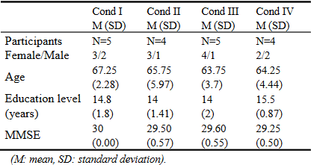
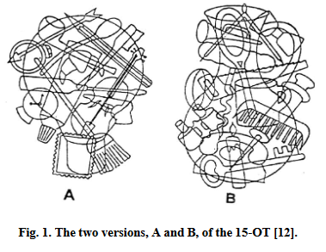
The Participants and the 2 versions of the 15-OT
The data gathered by the participants and the tests that were employed in either computerized or paper fashion.

Slide 33
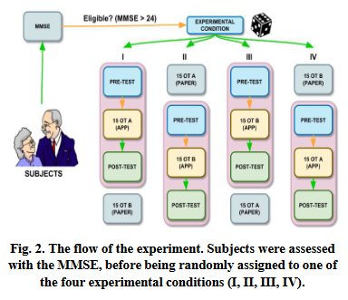
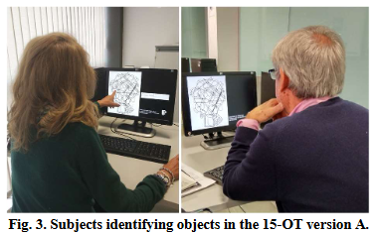
The Process in Choosing the Participants and the Test
Screenshot of the participants running the test and the experiment procedure.

Slide 34
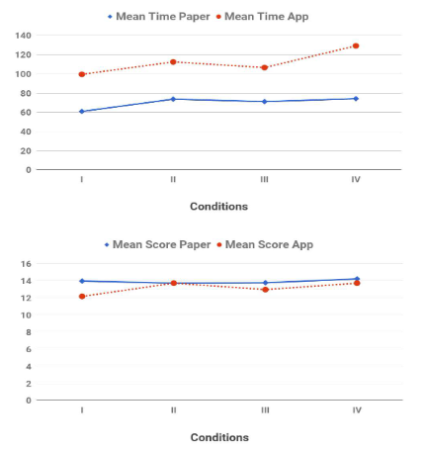
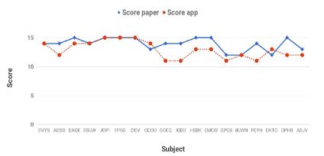
Test Results Part 1
The Score and Time comparison between the paper and computer version of the test.

Slide 35
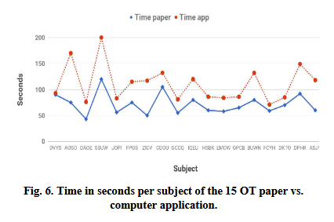
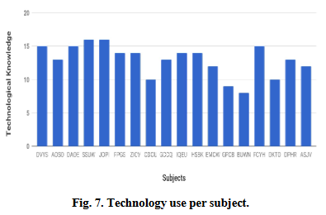
Test Results Part 2
More results regarding time per question and the technology use per participant.

Slide 36
Using Game Technology to Automatize Neuropsychological Tests and Research in Active Aging
Computerized version provides new data than the paper version related to detecting cognitive issues in older people
Regarding using the Unity engine to create and automize this application, it was a success and shows how game engine technology can be used in many fields than just game development (as said in the paper: medicine, education, etc.)
Called “serious games”

Slide 37
Using Game Technology to Automatize Neuropsychological Tests and Research in Active Aging
Only 18 participants of a specific demographic (healthy old men and women (12W/6M)), very limited sample size (mentioned that next tests will have a much bigger sample size)
While the computerized version does offer more auxiliary data from the tests, it does perform slightly worse from the paper version

Slide 38
Prospects
More research and testing needs to be done to compare the two different workflows and see how much of a difference there is by using a game engine rather than not
Game Engine Technology continues to improve to this day to add more tools and functionalities to allow studios to add more to their games and other projects
New applications can be done with game engines in the future depending on what new features are implemented (deeper presence in education and simulation)

Slide 39
Any Questions?

