Slide 1
House of the Small Cubes
Aditya Oka

Slide 2
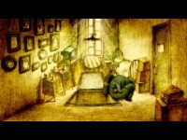

Slide 3

Details
Released on June 10, 2008
Written and Directed by Kunio Kato
Produced by Robot Communications and Animated by Oh! Production
Japanese short film that won Academy Award for Best Animated Short Film in 2009
First Asian to win an Academy Award for Best Animated Short Film

Slide 4
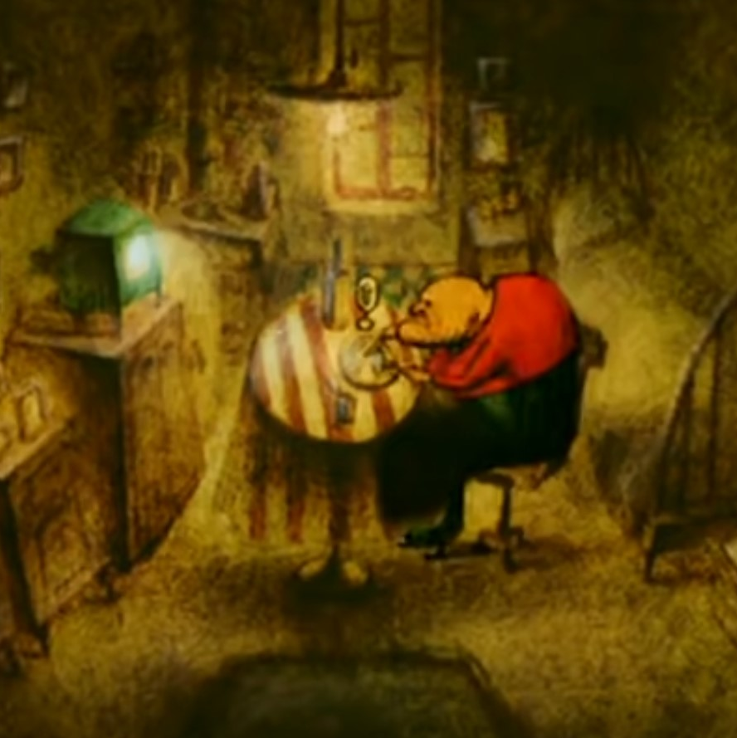
Summary
House of the Small Cubes or Tsumiki no le (La Maison en Petits Cubes) is a story about memories and the passage of time. With the ever-rising water symbolizing time, memories eventually get overrun by the tides, but they never disappear. Instead, they lie underwater, awaiting rediscovery.
In the beginning, the old man is seen doing his daily routine while living alone in his cube home tower, with several pictures of his family and mementos around the house. But when he drops his pipe and finally dives, he gets flooded with the memories of his past as he goes through each floor, all culminating to him reliving his childhood memories with his future wife (back in a time where there was no water). After that heavy experience, he pours a glass of wine for himself and his late wife, remembering their iconic moment together.

Slide 5
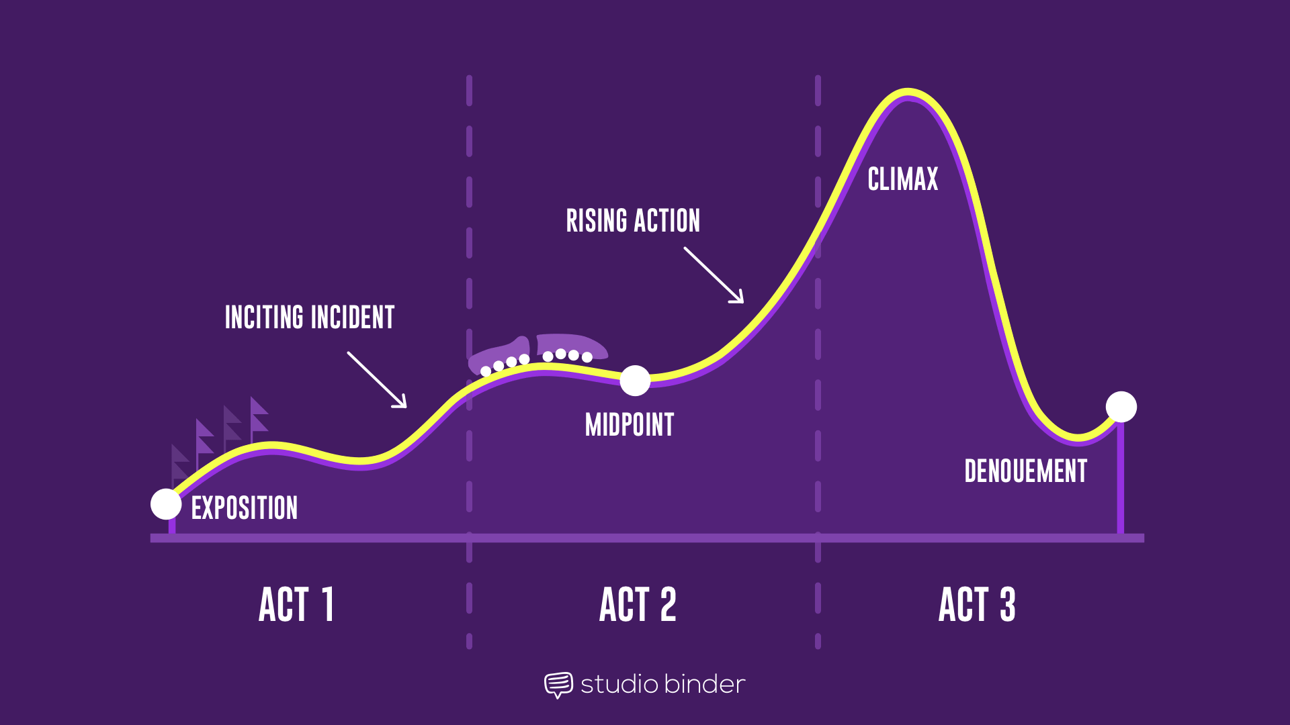
3 Act Structure
Act 1
Exposition: World is filled with water. Old man living alone in the house, fishing, eating dinner, and watching TV everyday.
Act 2
Midpoint: Old man starts to build another floor on top, moving all his stuff up.
Rising Action: While grabbing the TV from the flooded floor, he drops his pipe, and it sinks through the fishing hole.
Act 3
Climax: After getting his pipe in the dive, Old man dives further to remember lost memories of family (going all the way to the ground floor).
Denouement: Old man has a drink of wine during dinner on the new floor and clangs the wine glasses, callback to wife.
Inciting Incident: Water starts to flood the house.

Slide 6
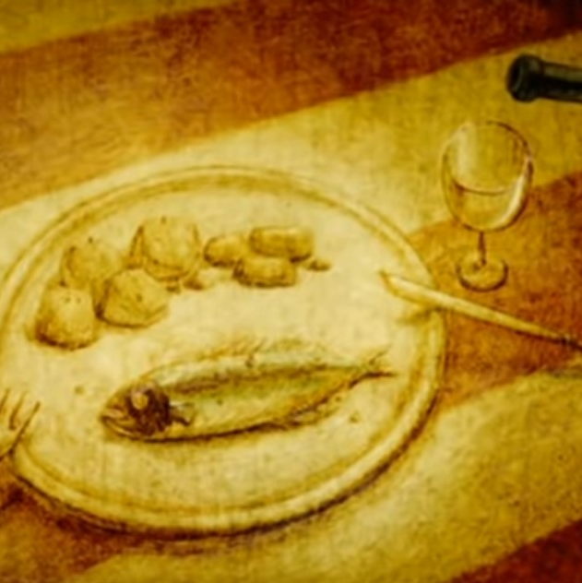
Animation Principles
Squash and Stretch
  Old Man’s face and body
Anticipation and Overlapping Action
  Old Man’s fishing rod, little girl’s doll
Secondary Action
  Boat rocking when Old Man moves, and TV is put in
Staging
  Lighting on key shots is exaggerated to direct the audience’s attention
Timing
  Gently putting the brinks on plaster vs. fishing rod and swimming
Solid Drawing and Appeal
  Unique architecture playing with 3D space and unique art style

Slide 7
Personal REVIEW

Slide 8

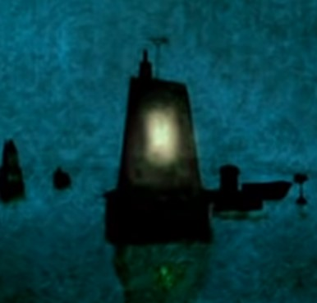
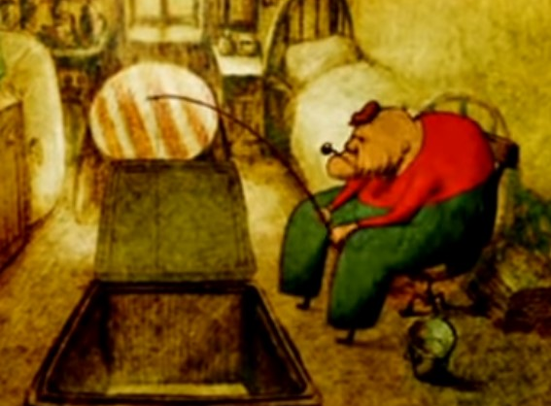
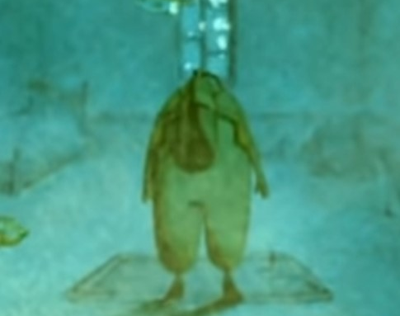
FIN

